Slide 1
Training Course contents
IDB
  Different types of IDB
  IDB Creation
  Different Template
  Connection
  Remote Testing
  VSWR
  BB Backup Time
  Alarm Logs
  Alarms Checking
  Sync Source
  KPI troubleshooting
  Sector Swap
  SFP

Slide 2
IDB
IDB
  Different types of IDB
  IDB Creation
  Different Template

Slide 3
IDB
OMT Information and 2G commissioning
Connect DUG by OMT
Format Flash card and load IDB and software

Slide 4
IDB
Create IDB
After load Flash card , create IDB from configuration > create IDB

Slide 5
IDB
Make IDB as required sectors and load in DUG

Slide 6
IDB
Load IDB and SW by OMT software as below have mentioned

Slide 7
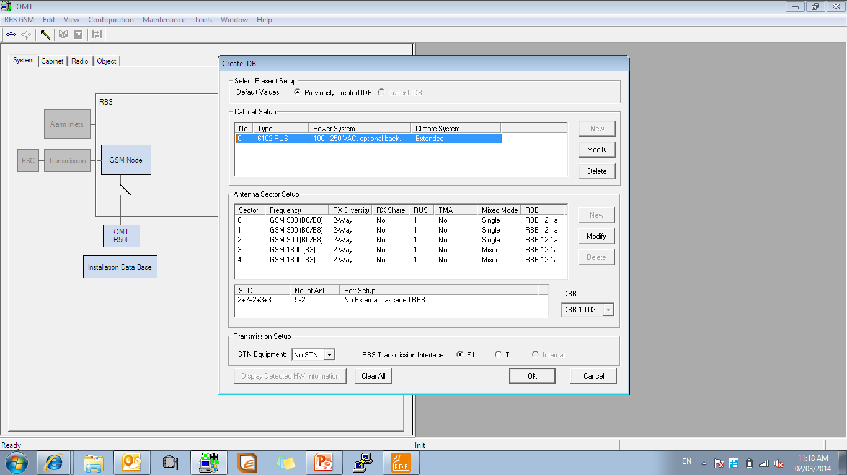
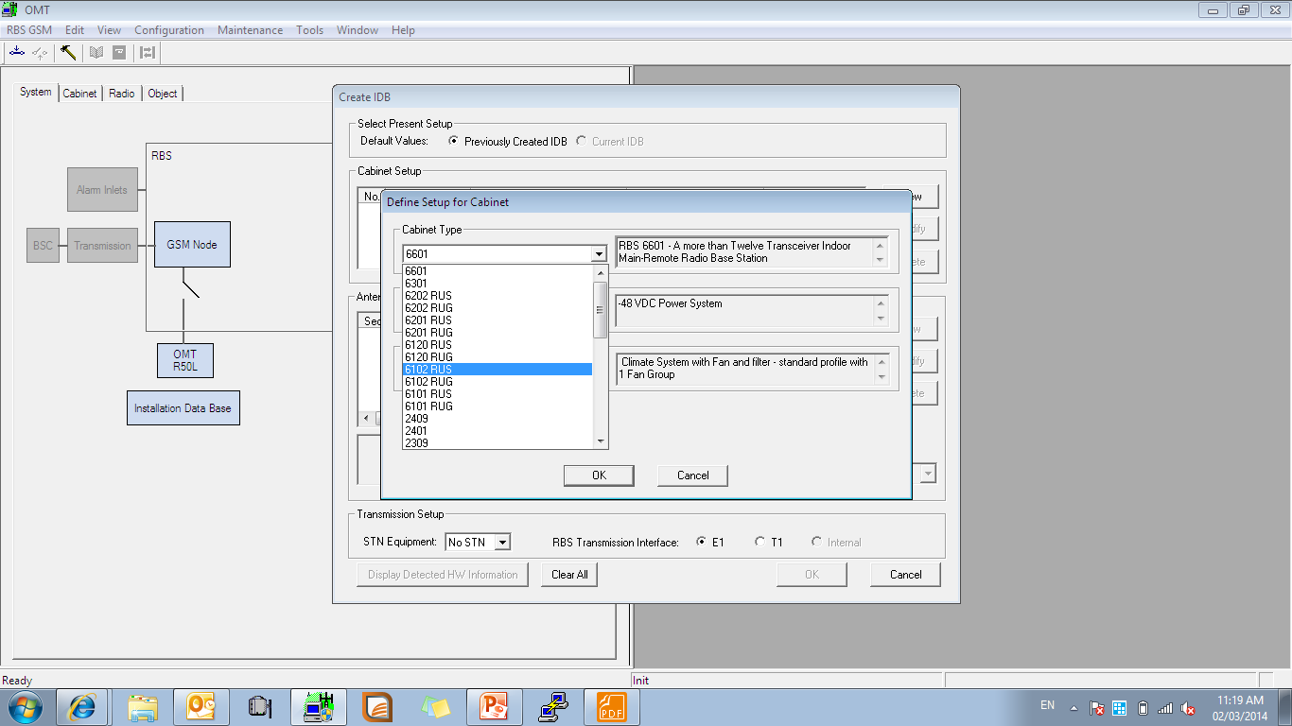
IDB
Select RBS type
Select RBS type
Notes:
نمایش منوی Create IDB

Slide 8
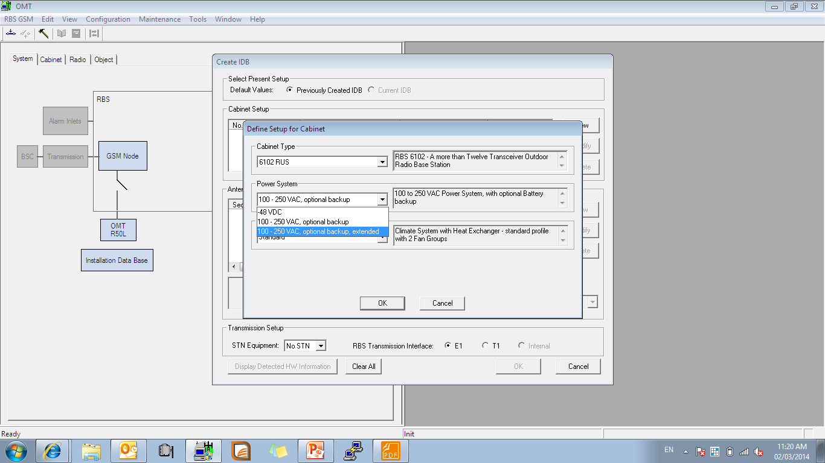
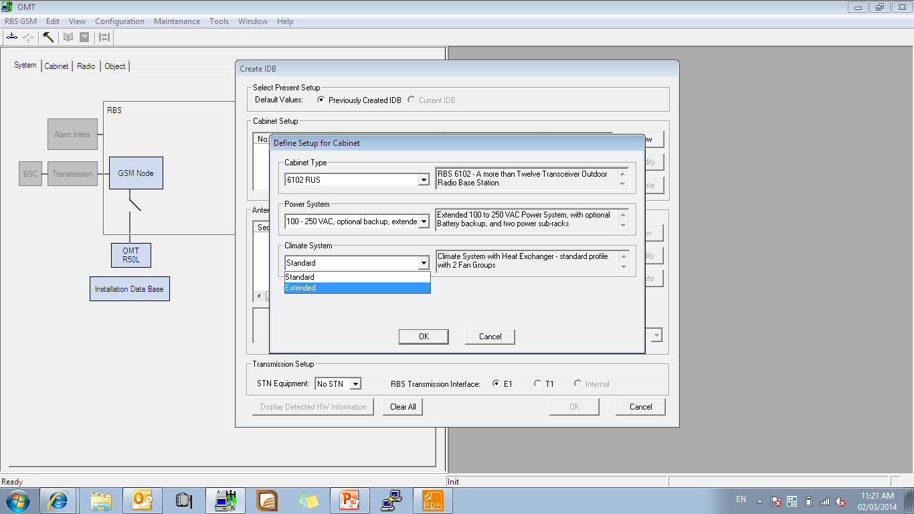
IDB
Select subrack options
Select climate system
Notes:
پاور را انتخاب می کنیم

Slide 9
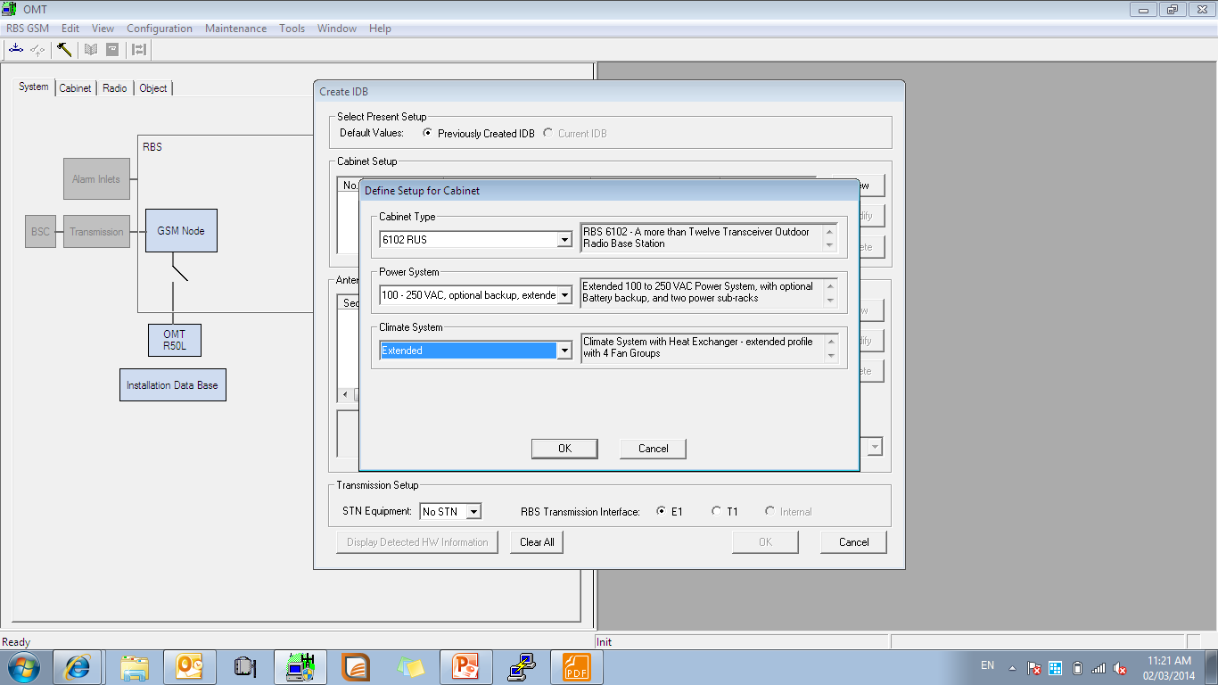
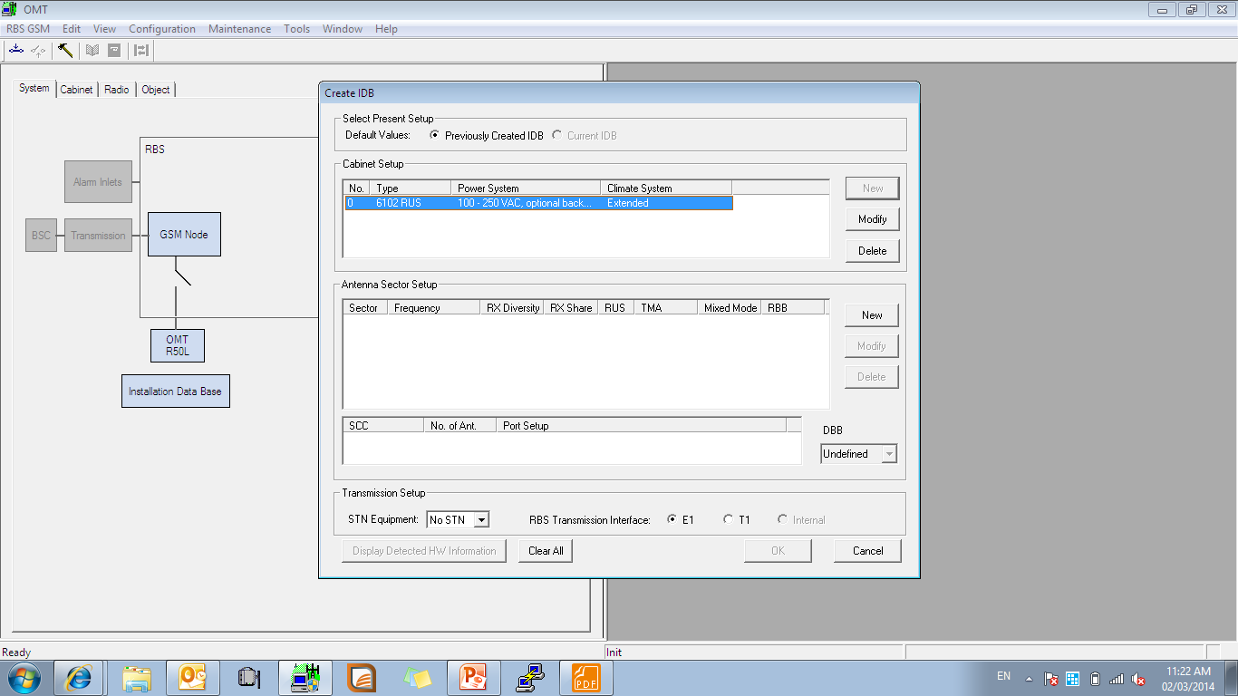
IDB
After finish press OK
Select Antenna sector setup
Notes:
بر روی ok کلیک می کنیم

Slide 10
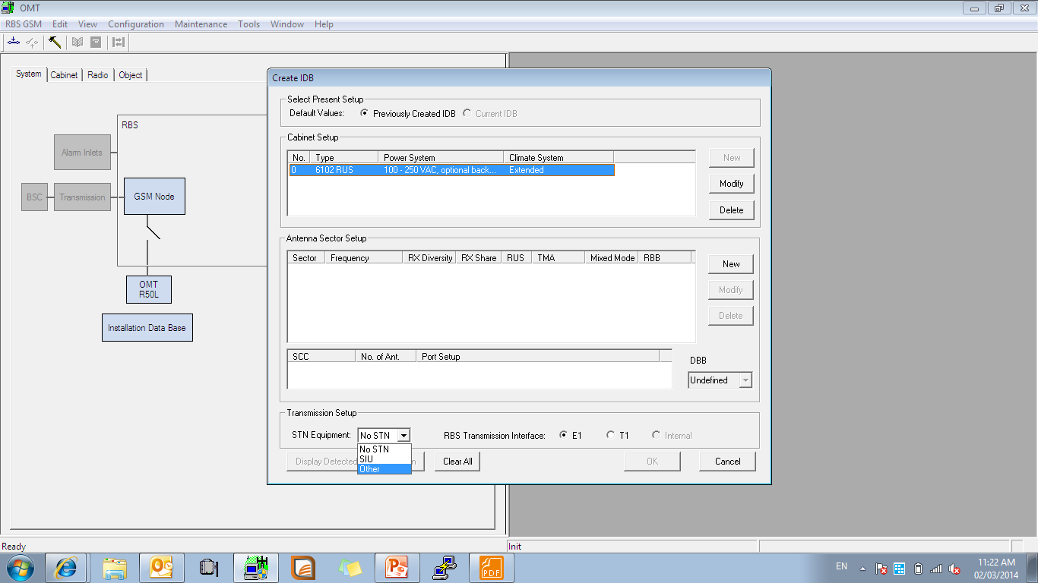
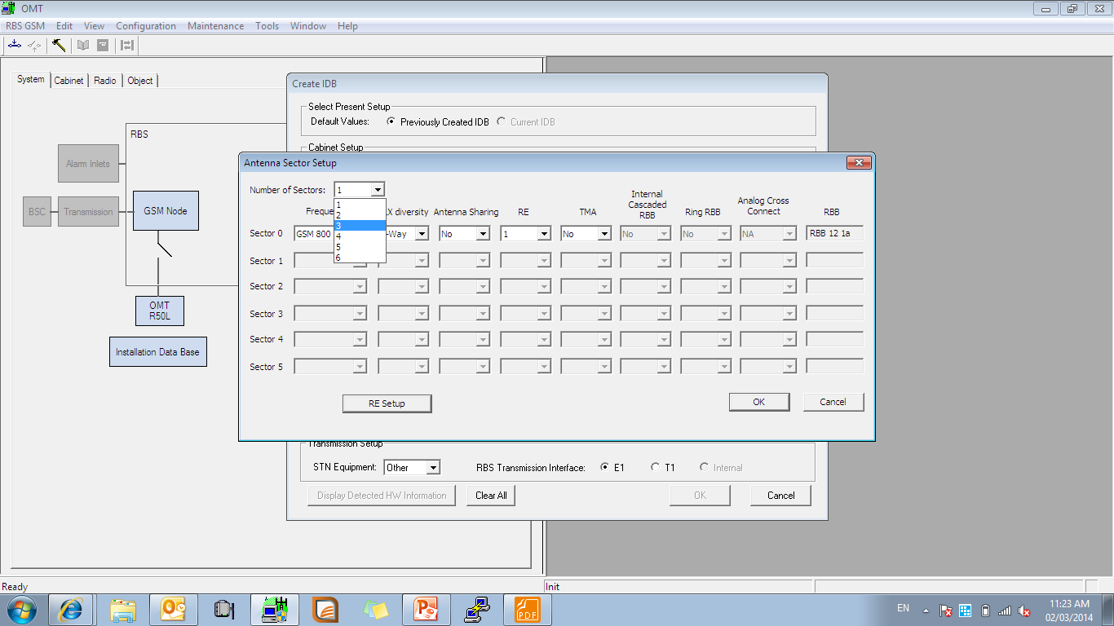
IDB
Select transmission option STN or SIU
Select sectors option
Notes:
نوع STN را انتخاب می کنیم

Slide 11
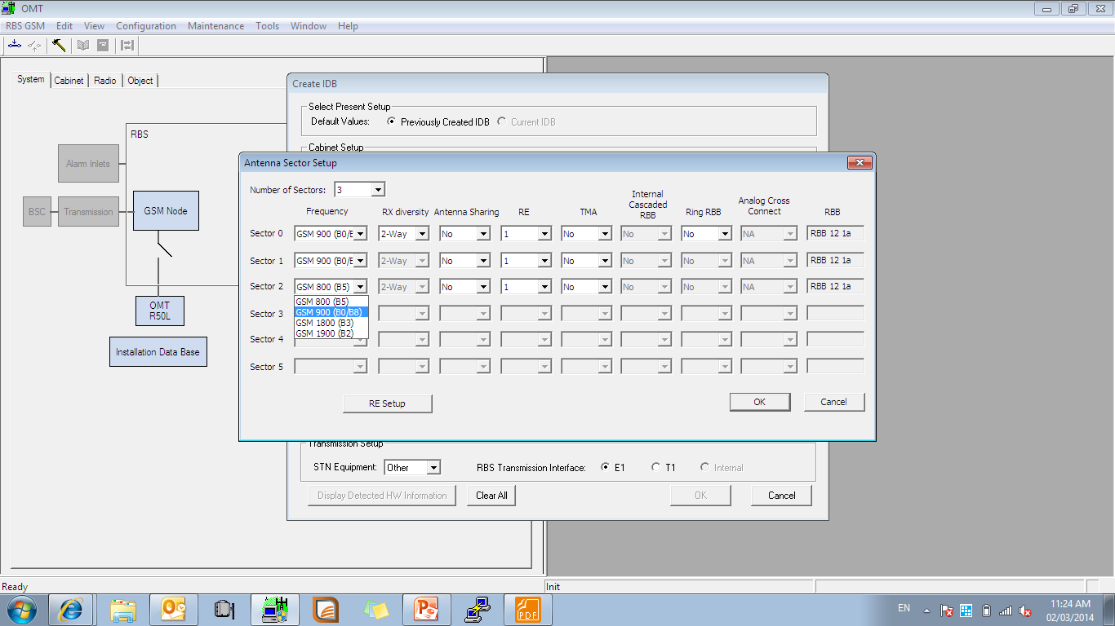
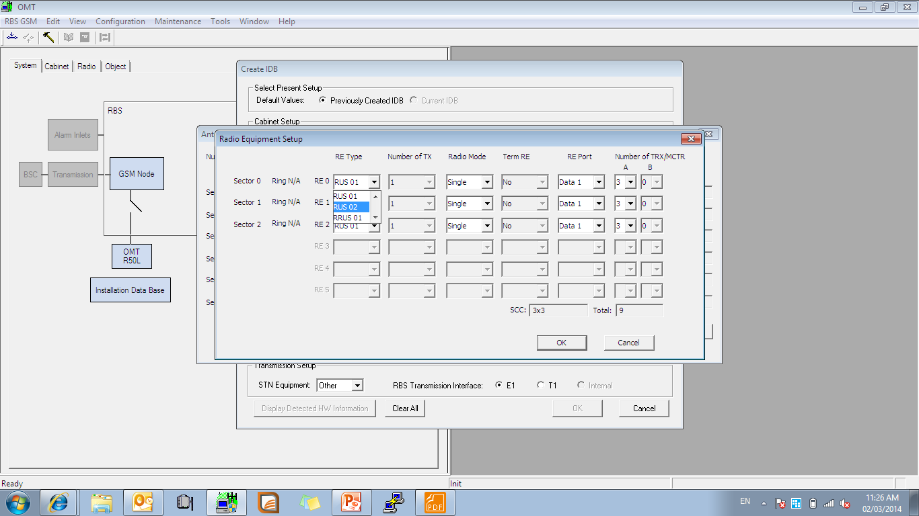
IDB
Select RUS type

Slide 12
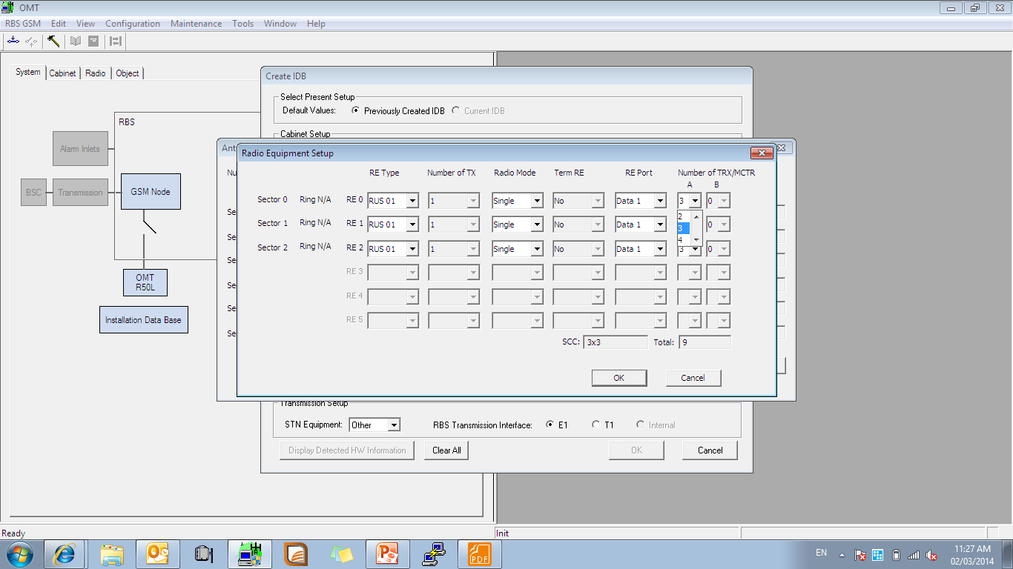
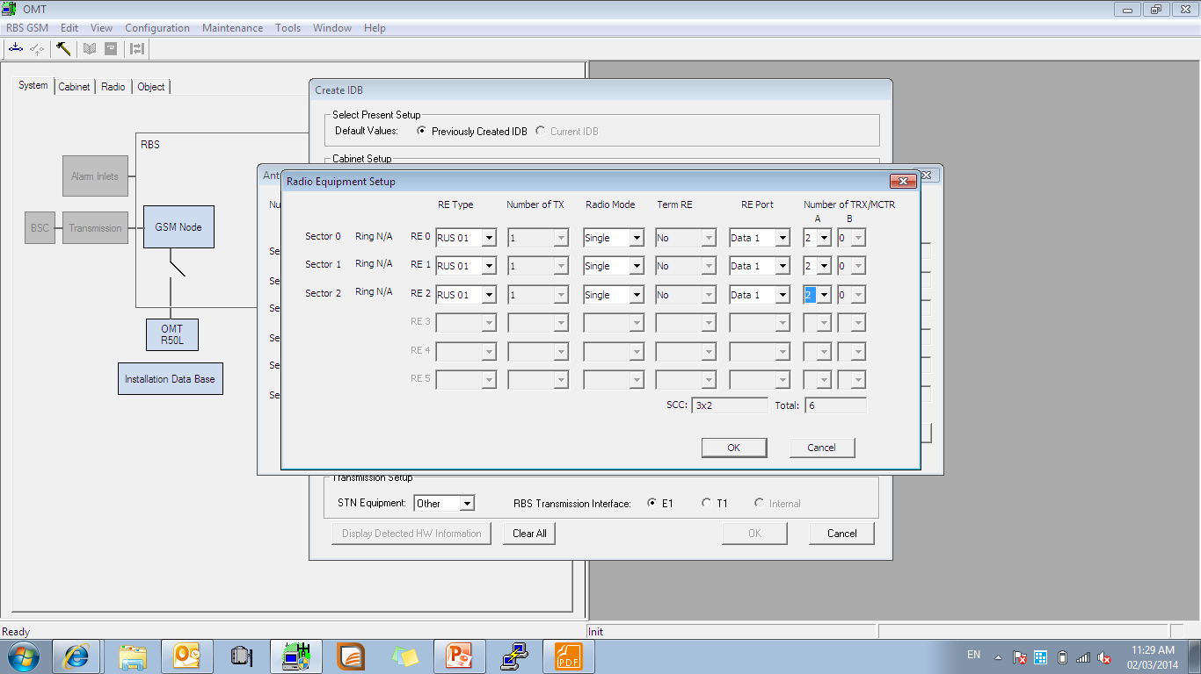
IDB
Select TRX as per plan e.g. 900 2+2+2

Slide 13
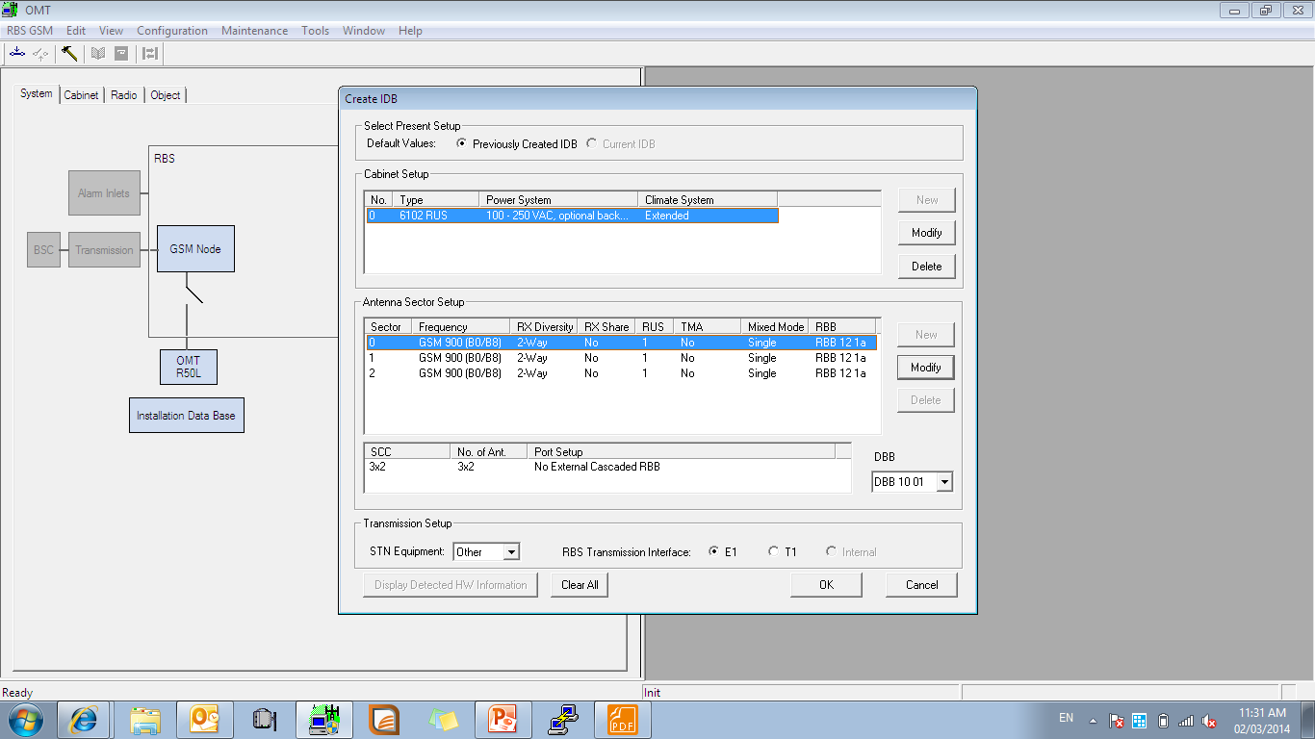
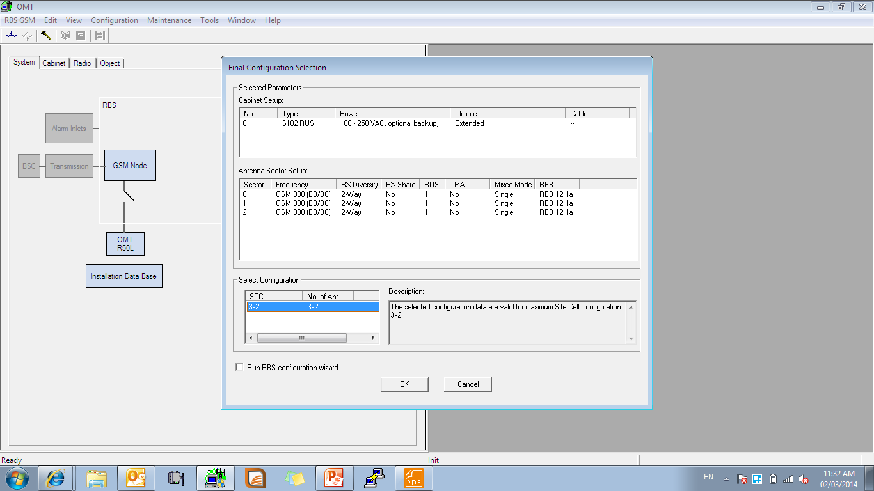
IDB
Recheck configuration here then press OK
Notes:
بر روی ok کلیک می کنیم

Slide 14
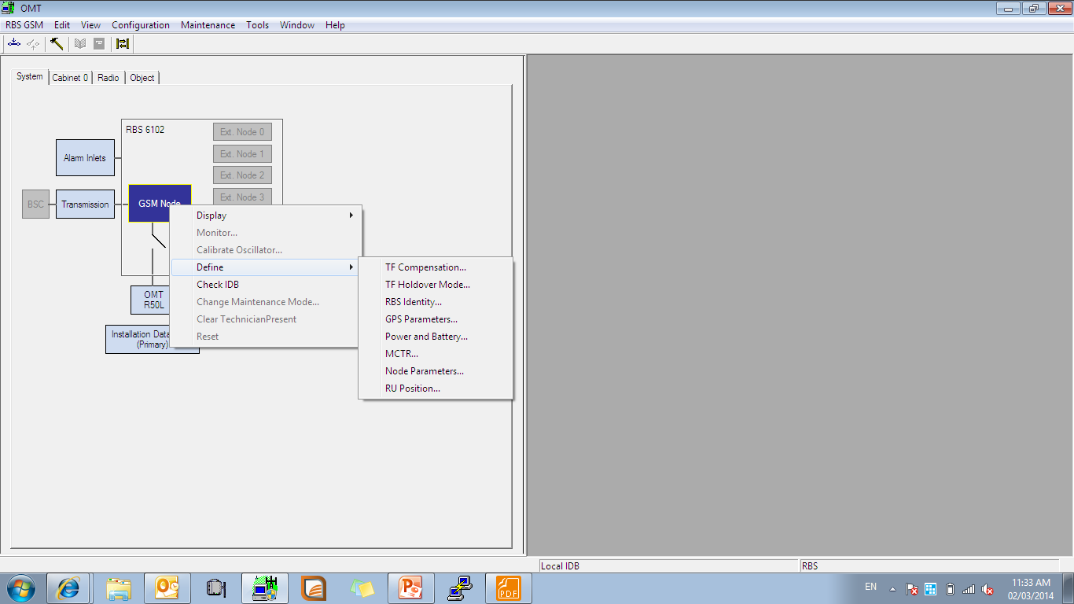
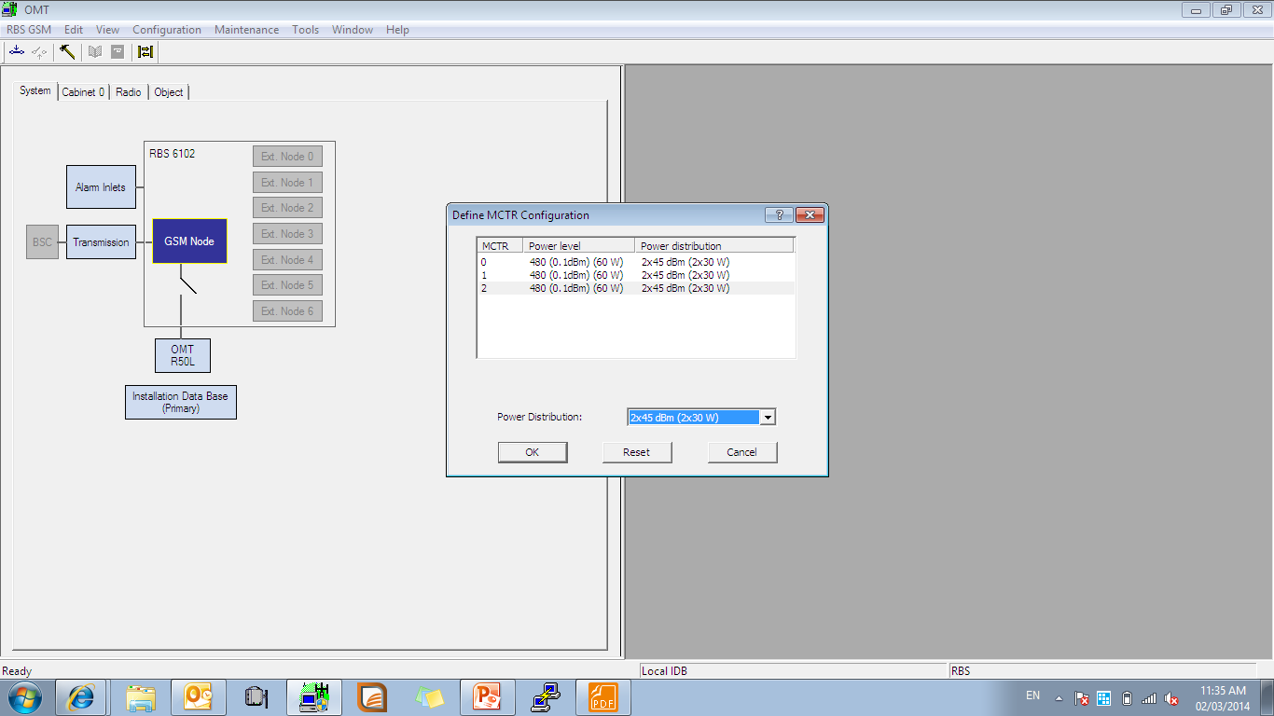
IDB
Right click at GSM > Define > Node Parameters
Select MCTR as per plan

Slide 15
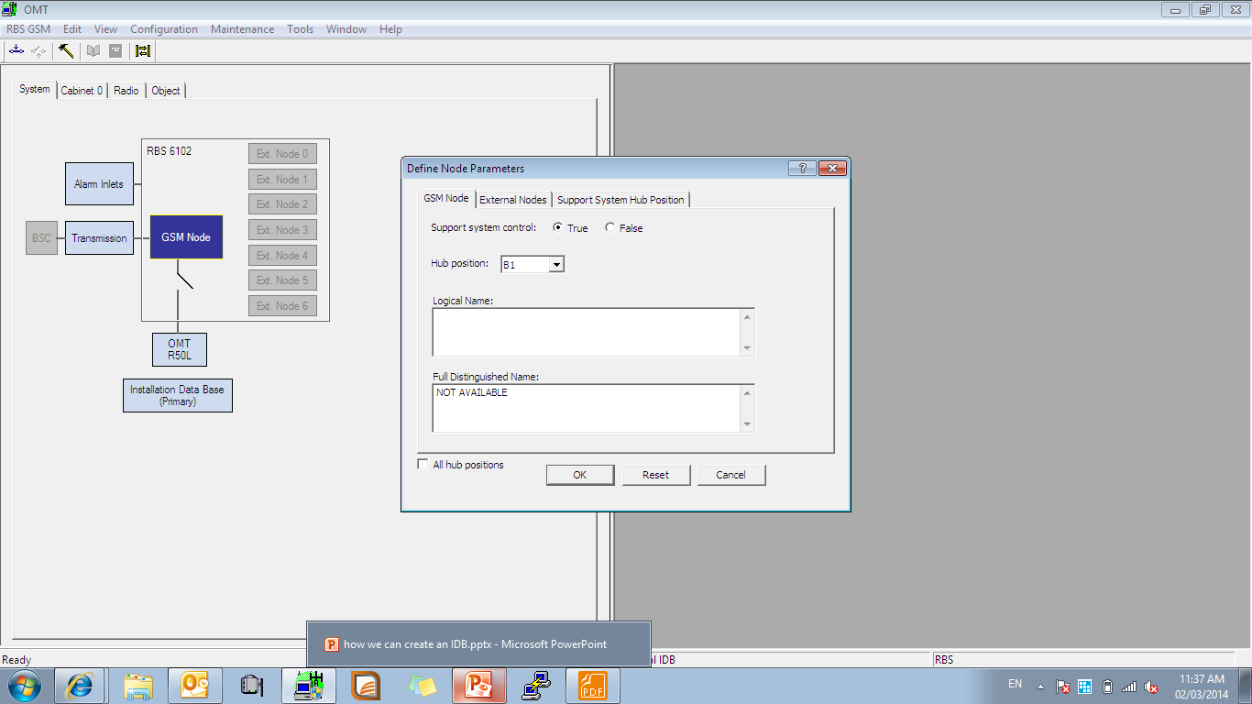
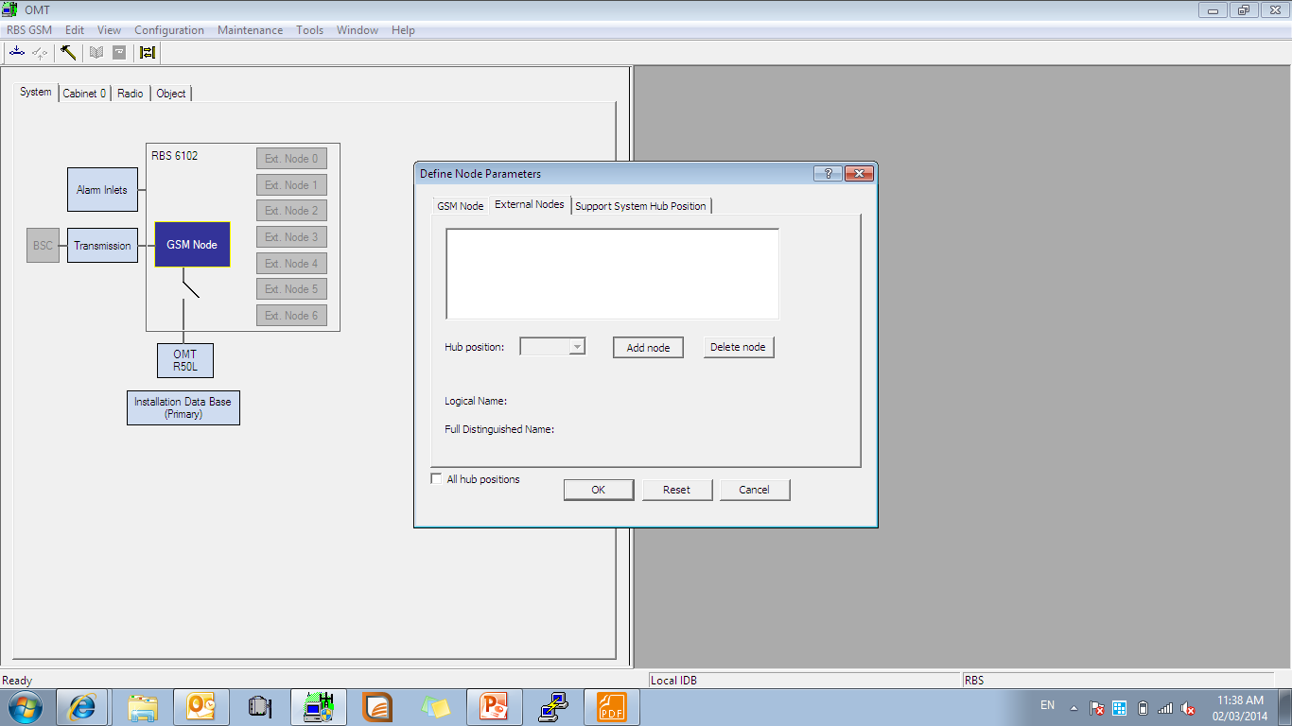
IDB
Select Node B1 for Master DUG
Add Nodes for WCDMA, 1800 , LTE

Slide 16
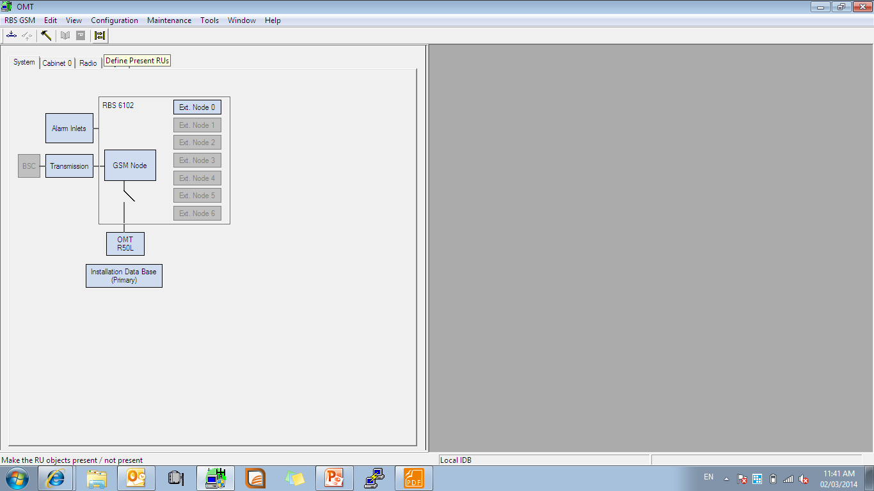
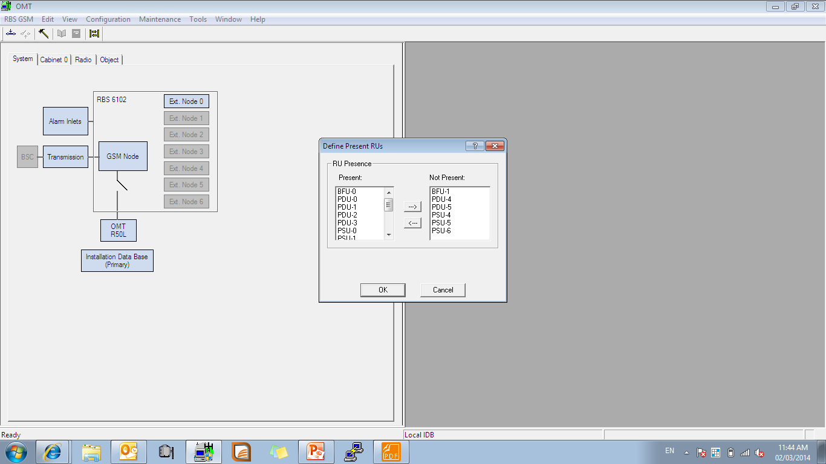
IDB
Here Node will show
Present all required RU and units

Slide 17

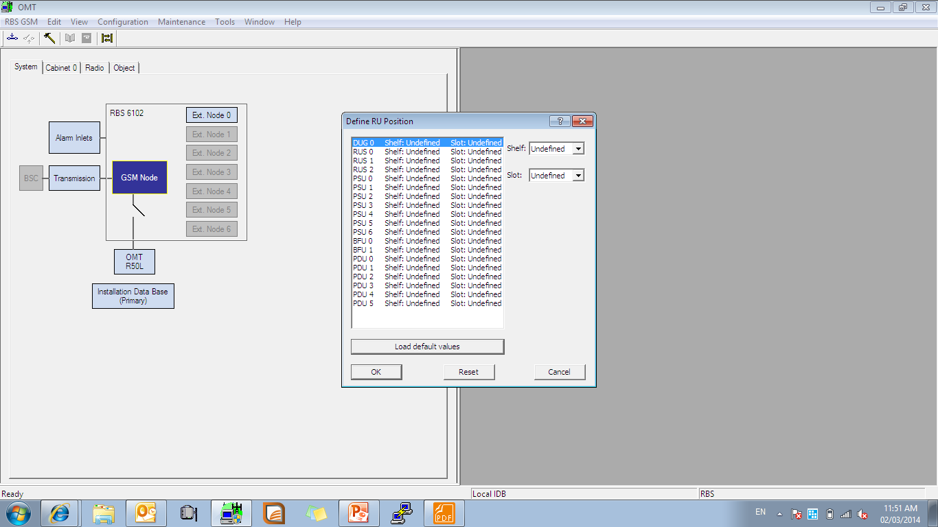
IDB
Select RU position
Define RU as per HW structure

Slide 18
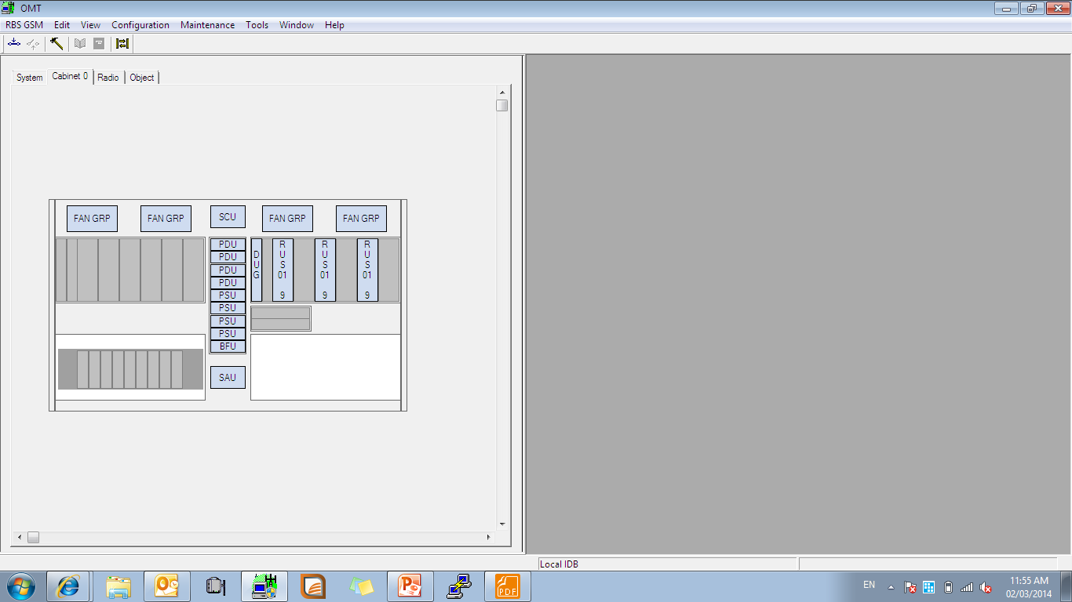
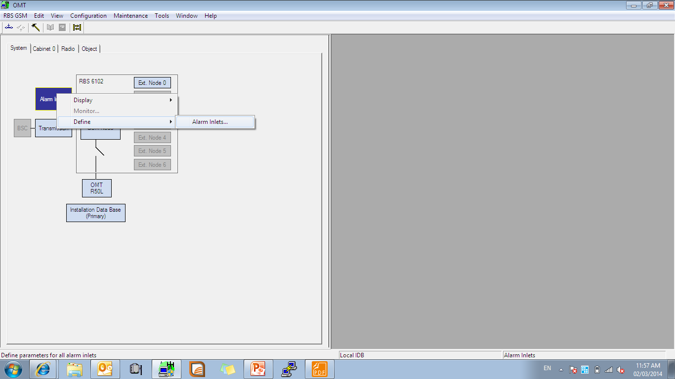
IDB
After RU definitions
Define Smoke : Right click Alarms > Define > Alarm Inlets

Slide 19
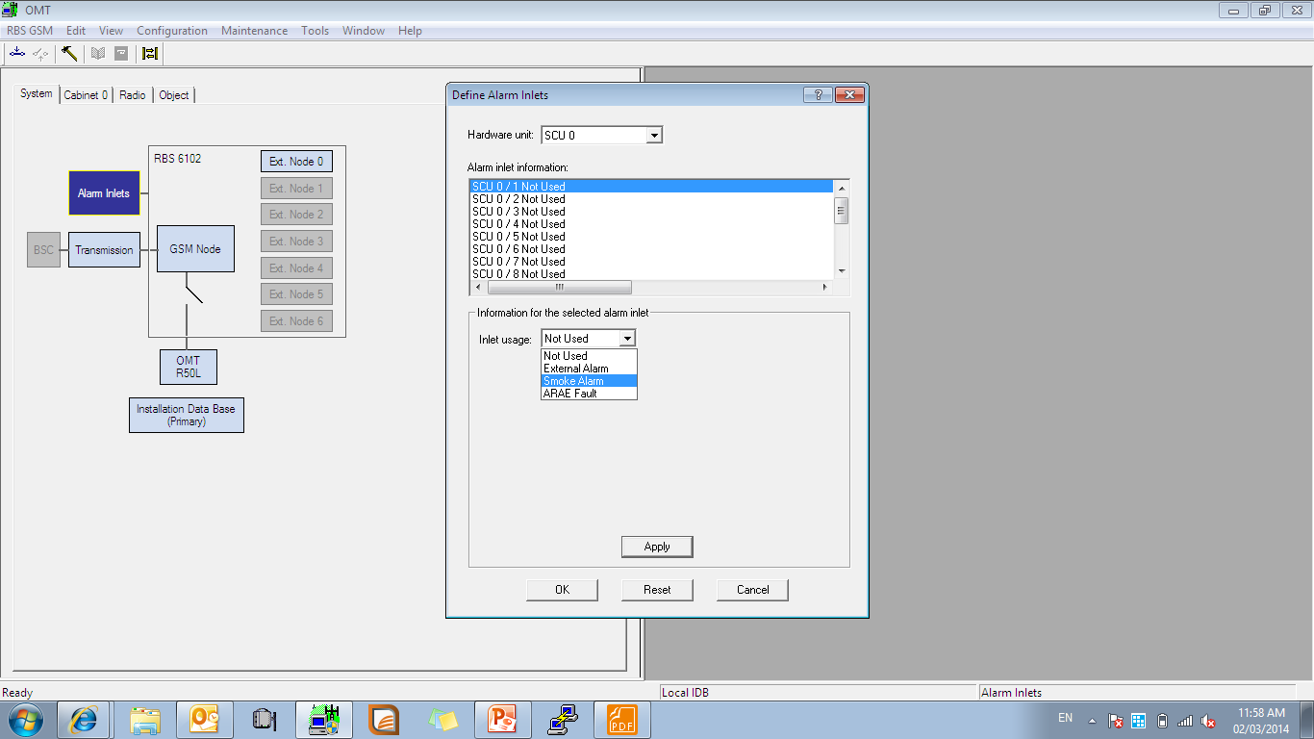
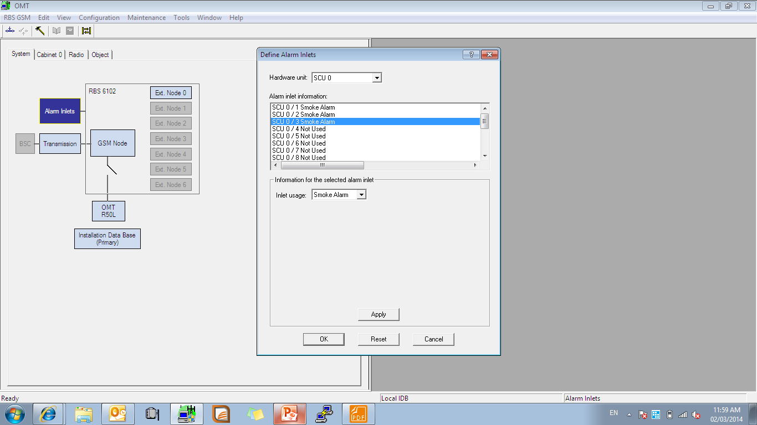
IDB
Select Smoke Alarm
Press Apply
Notes:
بر طبق شکل آلارم Smoke را تعریف می کنیم

Slide 20
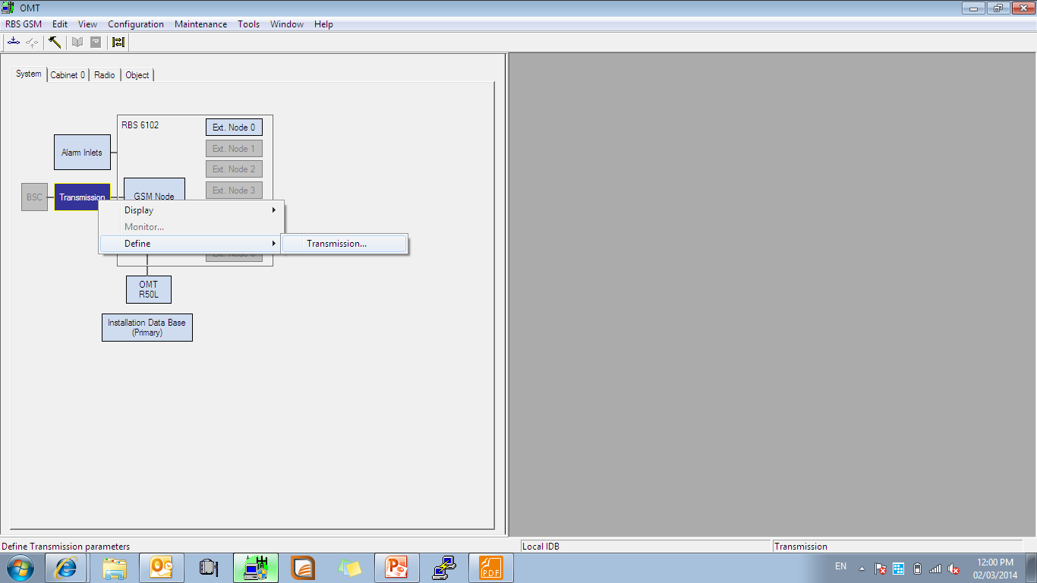
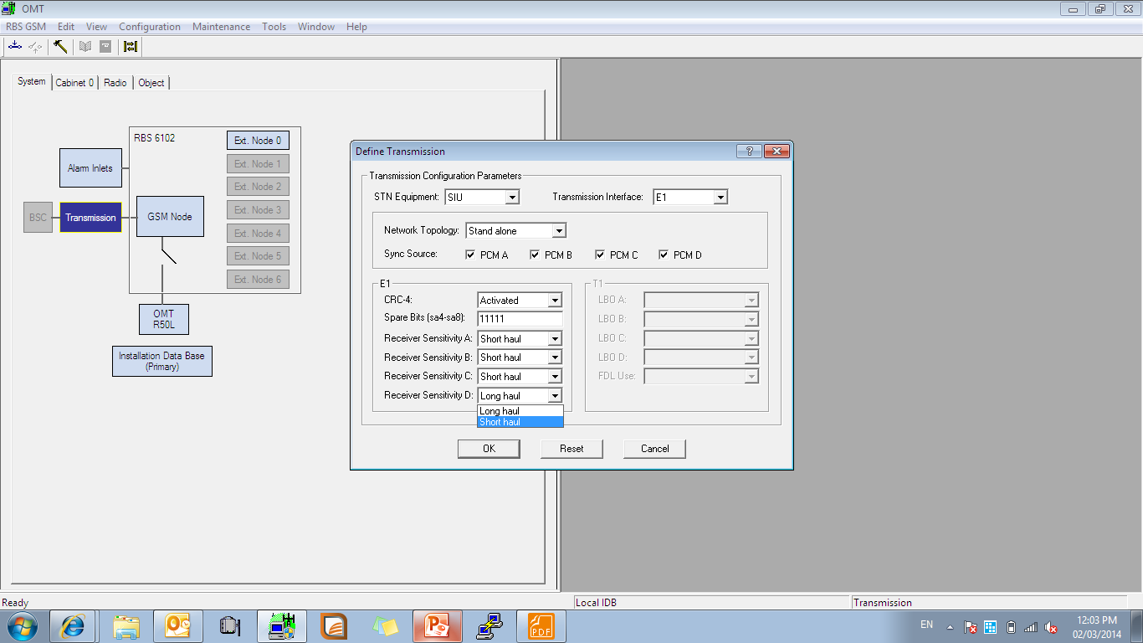
IDB
Right click Transmission > Define > Transmission
Select here type of Transmission

Slide 21
Connection
Connection
  DUG to DUG connection
  DUG to DUW Connection
  DUG to DUS connection

Slide 22
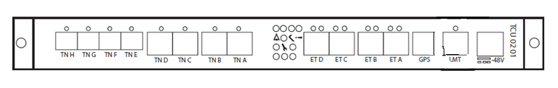
Connection
RBS TCU Connection
RBS and DUG connection should be done between ET ports. The ETA port in the first DUG should be connected to ETA port on the TCU. And the ETA port in the second DUG should be connected to ETA port on the TCU. Each ET ports support 2E1s.
If 4E1 used per DUG then, The ETA port in the first DUG is to be connected to ETA on TCU, ETB port in the first DUG is to be connected to ETB on TCU. And the ETA port in the second DUG is to be connected to ETC on TCU; ETB port in the second DUG is to be connected to ETD on TCU.
The Connection towards TN has to be done via TN_A port with a straight (RJ45) cable.

Slide 23
  Remote Testing
  Remote Testing
  VSWR
  BB Backup Time
  Alarm Logs

Slide 24
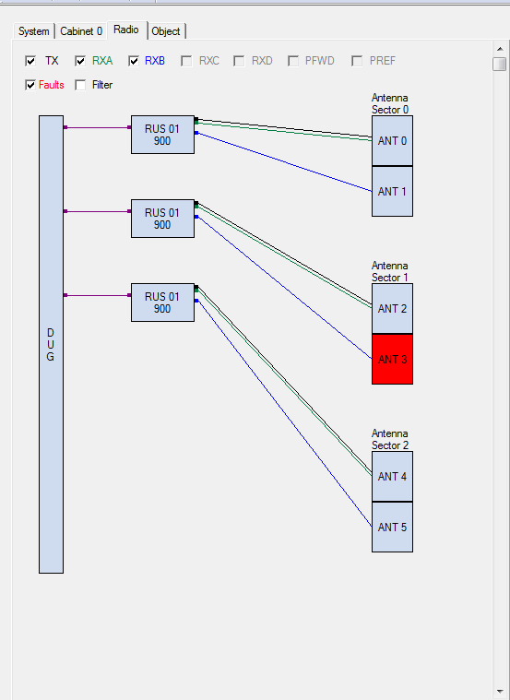
  Remote Testing ( VSWR )
Check Faults from Radio part that which RUS has VSWR issue

Slide 25
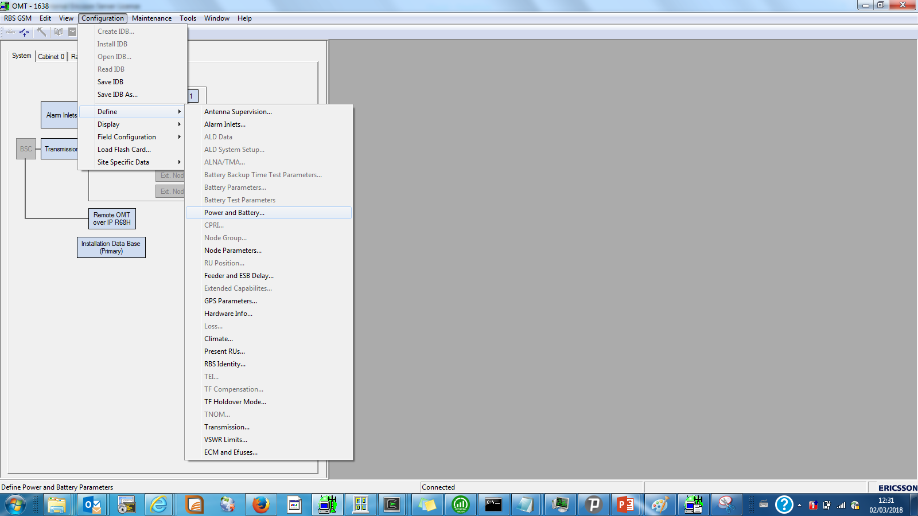
  Remote Testing ( BB Test )

Slide 26
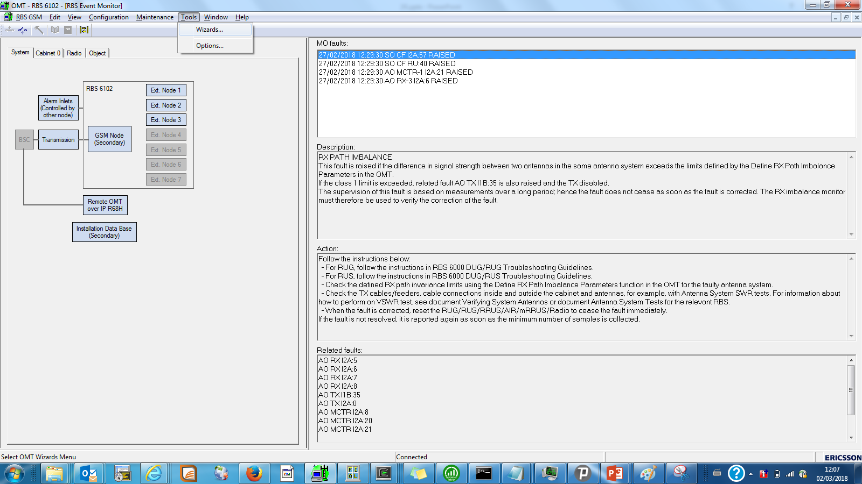
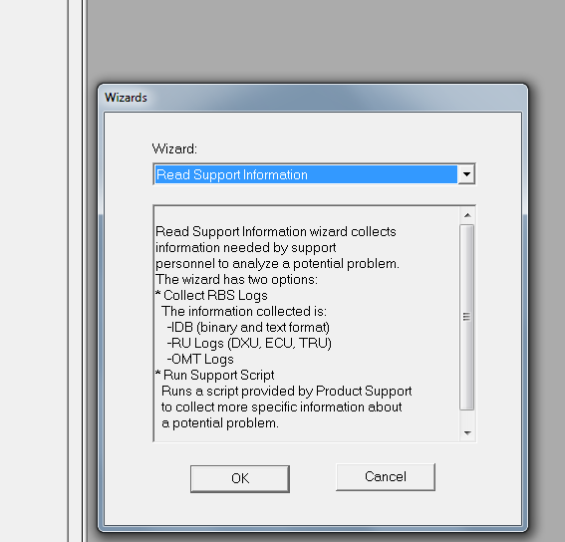
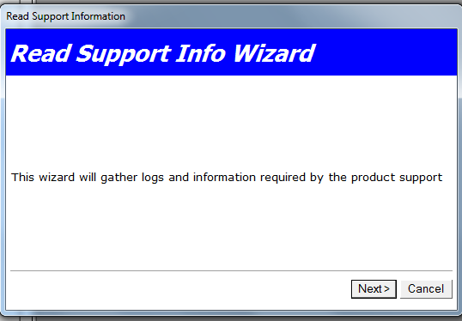
  Remote Testing ( RBS Logs )
For taking RBS logs please follow below steps

Slide 27
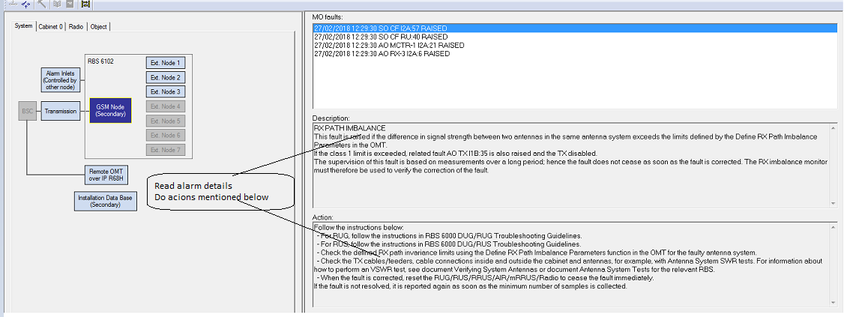
  Alarm Checking
Check Alarm details in Description and than take necessary actions written in ACTION part

Slide 28
  Sync Source
  Sync Source

Slide 29
  Sync Source

Slide 30
  KPI troubleshooting
  Troubleshooting
a. Check physical links to the transport network are up.
b. If using Ethernet transport, verify that Ethernet Port TN_A is enabled, TN_A LED should be blinking
c. If using E1 transport, verify that all E1 ports are enabled. If there are 2 E1s connected, the leds on E1/T1 Port ETA should be on
Note: The Ethernet ports towards the TN will not be enabled until after the RBS is integrated.
d. Check alarms
"getalarmlist"
Note: The TCU should be fault free.
e. ping PGW IP address in configuration file to verify that BSC is reachable
"ping "PGW IP Address""

Slide 31
  Sector Swap
Complete Swap
Partial Swap
CPRI Swap

Slide 32
  Sector Swap
Complete Sector Swap
  For this kind of Swap means that one sector is completely swapped with another sector for example XA is fully swapped with XB, both TX and RX branch
  Partial Swap
    Partial Swap means that TX and RX cable has been swapped on same sectors.
  CPRI Swapped
    For checking this kind of swap please verify that CPRI cables between DUG/DUW/DUS and RUS should be connected on correct port of DUG/DUW/DUS.

Slide 33
  SFP
During troubleshooting sector fluctuation or sector down please verify that CPRI installed in DUW/DUS and RRUs are of same product.

