Slide 1
Training Course contents 3G
Basic Integration
Scripting
Configuration and connections
Sync
Node Group
Basic Commands
Common Faults
Field Level training Material

Slide 2
Basic Integration
Basic integration steps
Laptop configuration
Format and load Files again

Slide 3
Scripting
Basic Scripts for 3G
How many Scripts required
How to make scripts
How to load scripts

Slide 4
New dual DUW commissioning
Configuration and Connections
If the RBS 6000 3G will be configured from scratch, the steps will be:
Format and load basic package to primary (1st) DUW.
Format secondary (2nd) DUW.
Turn off 2nd DUW, connect IDL and F to F cable between both DUWs.
Turn on 2nd DUW, then run Cabinet Equipment from 1st DUW.
Wait until both DUW are synchronized.

Slide 5
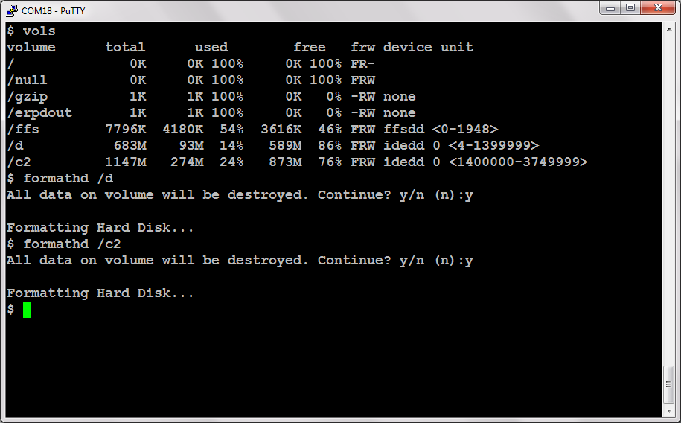
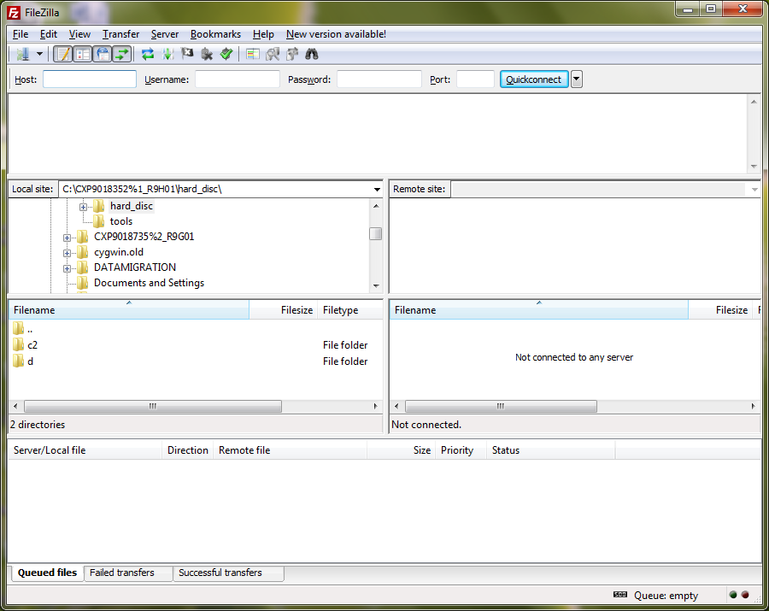
Format and load basic package to 1st duw

Slide 6
Format 2nd duw

Slide 7
Cable connection
Turn off 2nd DUW, connect IDL and F to F cable between DUW then turn the 2nd DUW on.
IDL cable
F to F cable

Slide 8
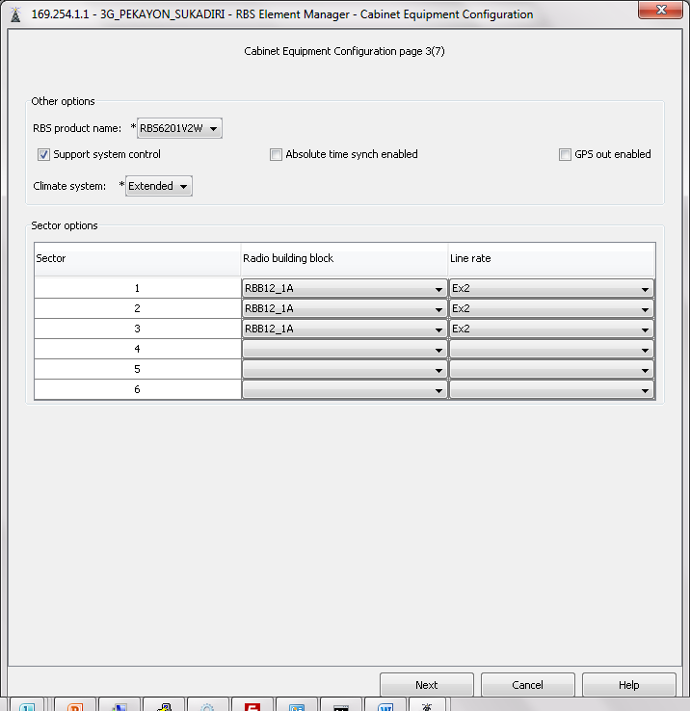
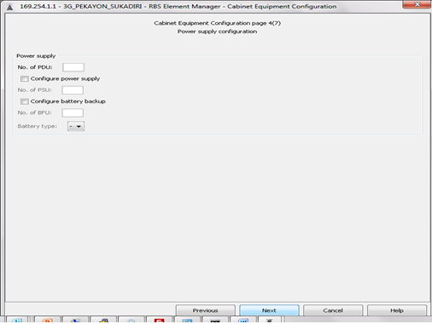
Cabinet equipment 1st DUW

Slide 9
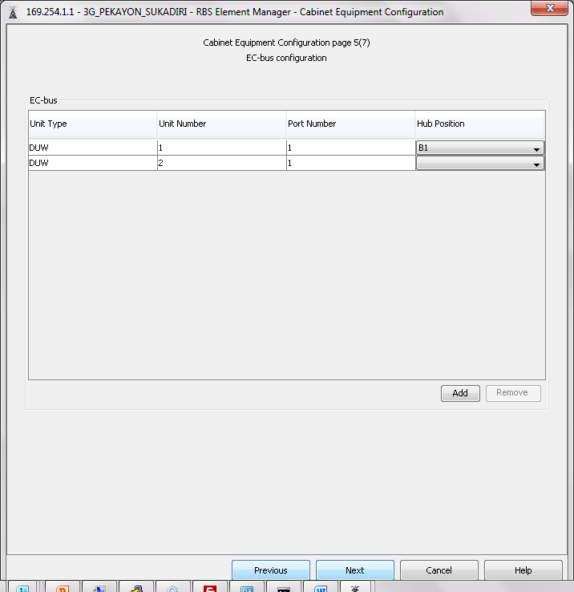
Cabinet equipment
If new DUW doesn’t appear, 2nd DUW might not be detected by the primary.
If that happens, please check:
IDL and F to F cable connection.
You might need to repeat cabinet equipment configuration.

Slide 10
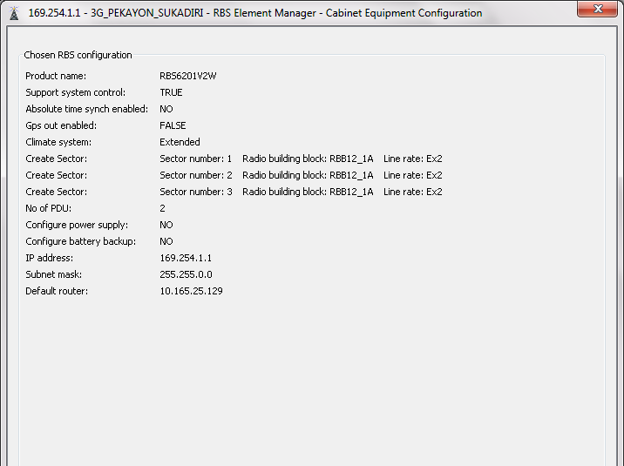
Cabinet equipment

Slide 11
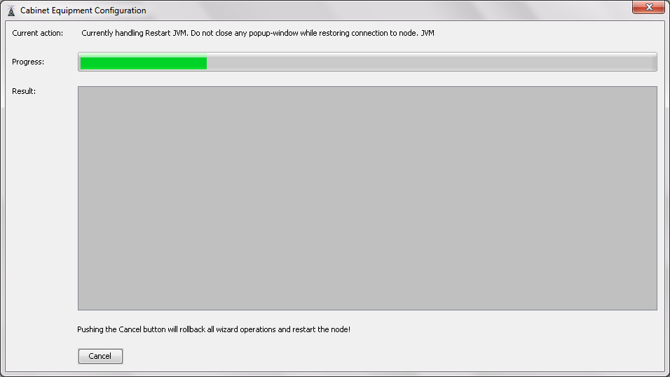
Cabinet equipment

Slide 12
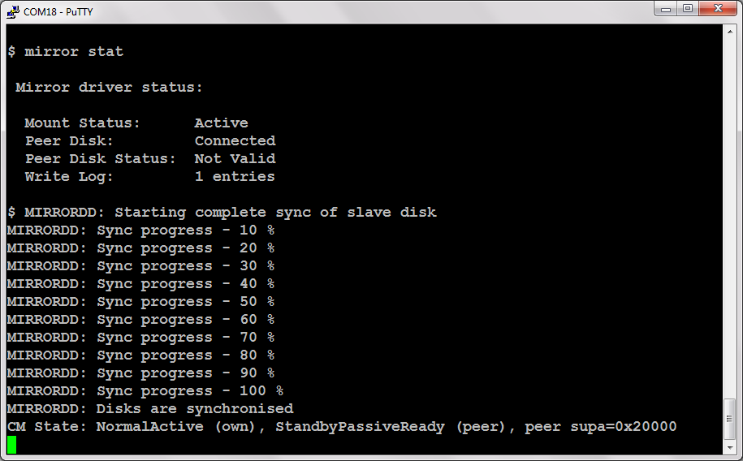
Wait for disk synchronization

Slide 13
2nd DUW status – PASSIVEREADY

Slide 14
Add new DUW with export & delete(second situation)
If 2nd DUW will be added to existing live RBS 6000 3G:
Format 2nd DUW, turn it off after the format process finish.
Create backup CV and run export & delete from 1st DUW.
Connect IDL cable and F to F cable between both DUWs.
Turn on 2nd DUW, then run cabinet equipment from 1st DUW.
Wait until both DUWs are synchronized.

Slide 15
Format 2nd duw

Slide 16
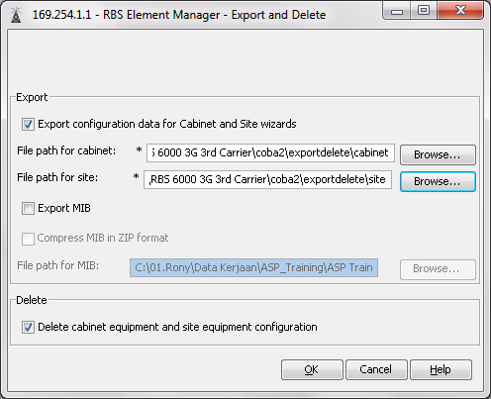
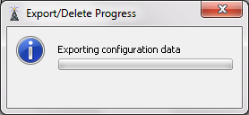
Export & delete

Slide 17
Cable connection
Turn off 2nd DUW, connect IDL and F to F cable between DUW then turn the 2nd DUW on.
IDL cable
F to F cable

Slide 18
Cabinet equipment 1st DUW

Slide 19
Cabinet equipment
If new DUW doesn’t appear, 2nd DUW might not be detected by the primary.
If that happens, please check:
IDL and F to F cable connection.
You might need to repeat cabinet equipment configuration.

Slide 20
Cabinet equipment

Slide 21
Cabinet equipment

Slide 22
Wait for disk synchronization

Slide 23
2nd DUW status – PASSIVEREADY
After both DUW are synchronized, load the site equipment configuration

Slide 24
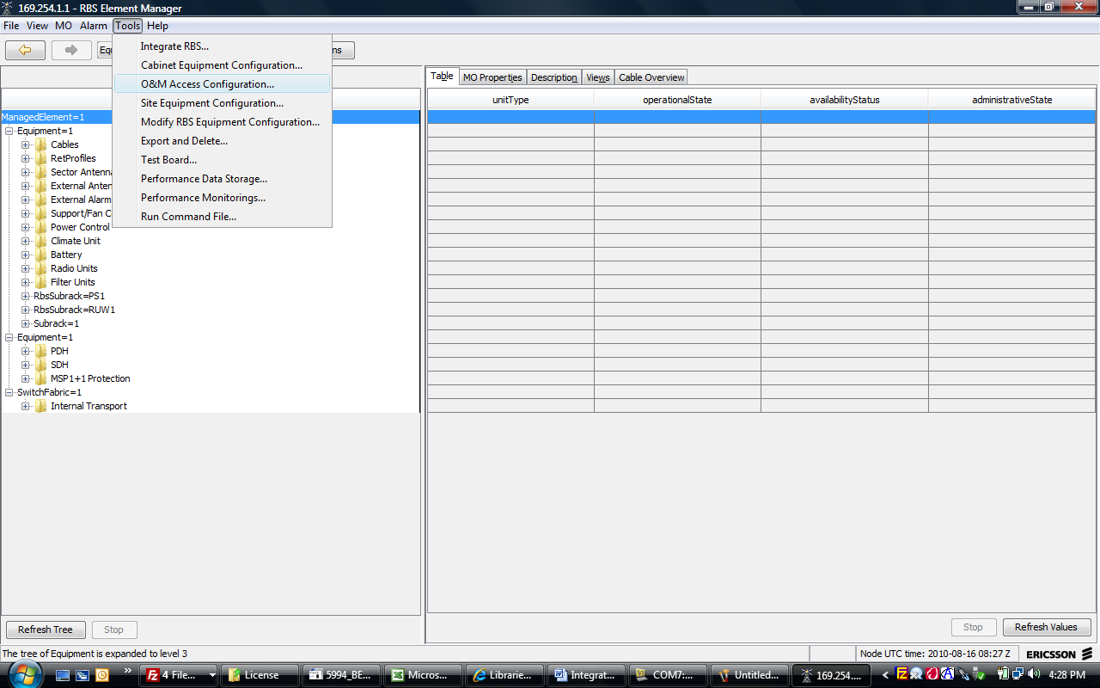
OAM Script To run the OAM wizard, from the tools menu select OAM access configuration.

Slide 25
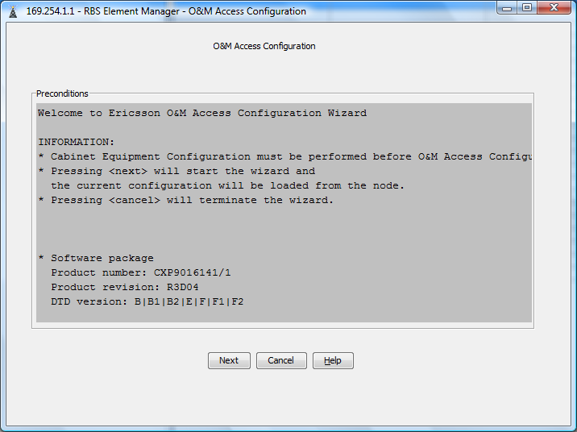
You will see the screen below do next.

Slide 26
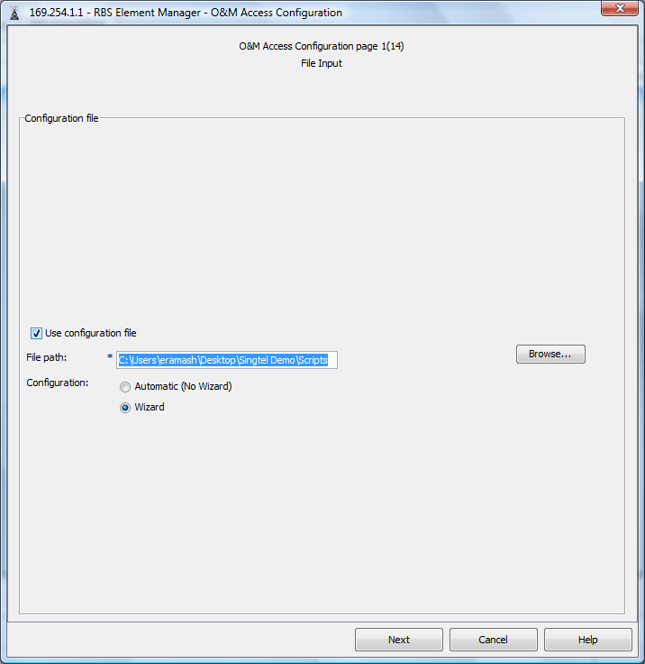
Select file from your drive location and do next.

Slide 27
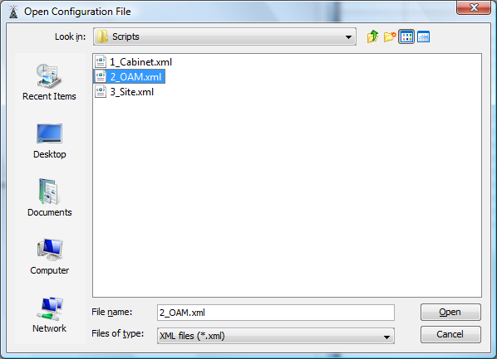

Slide 28
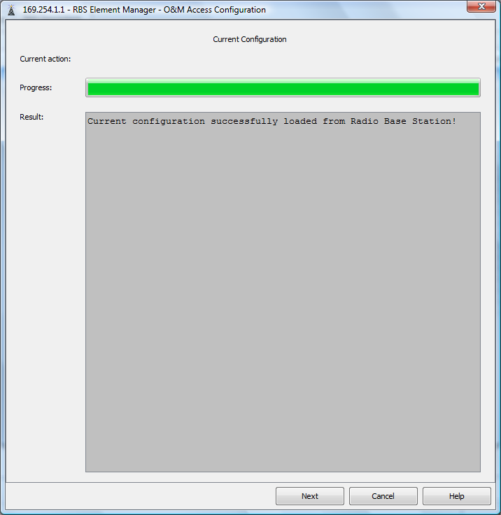

Slide 29
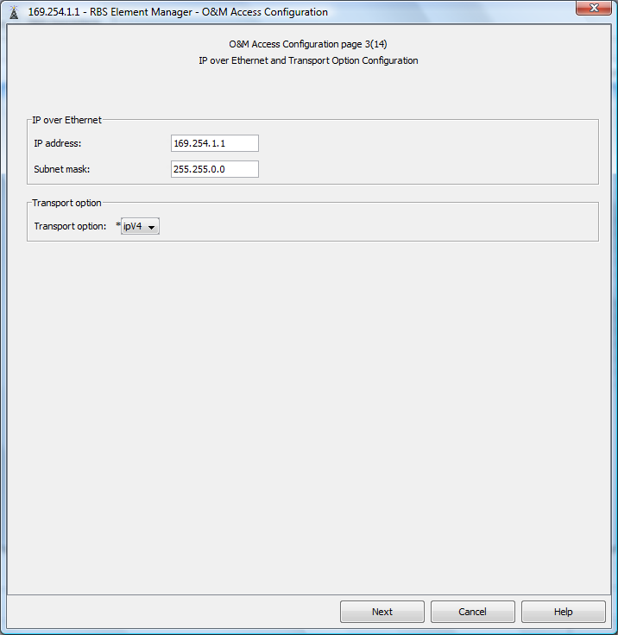

Slide 30
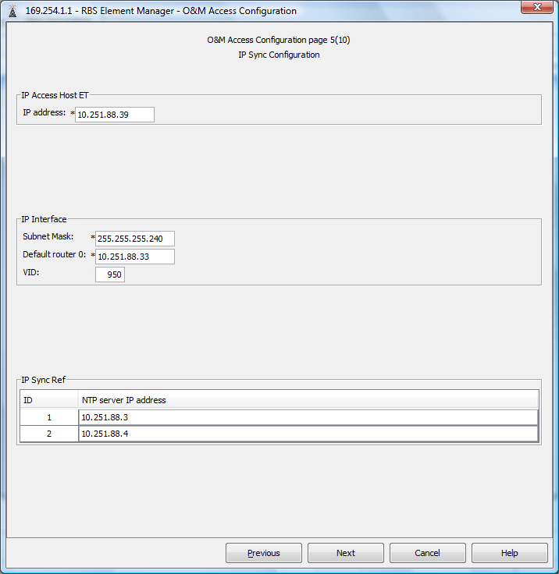

Slide 31
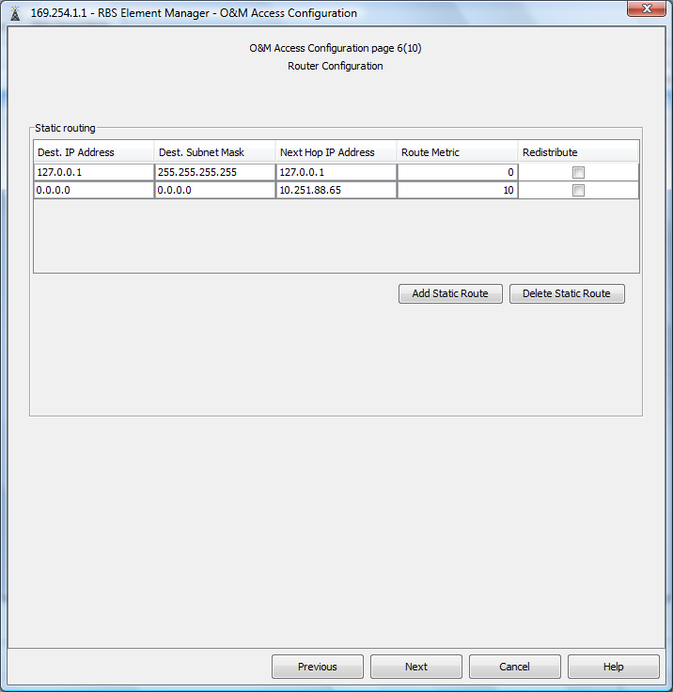

Slide 32
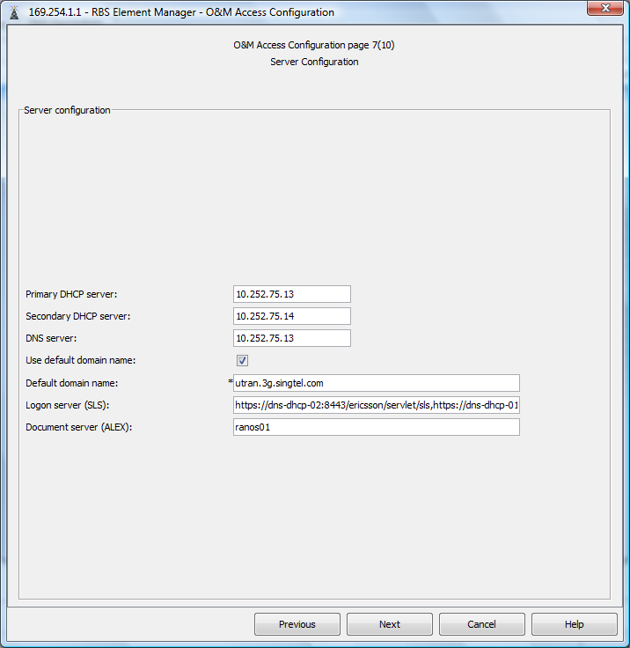

Slide 33
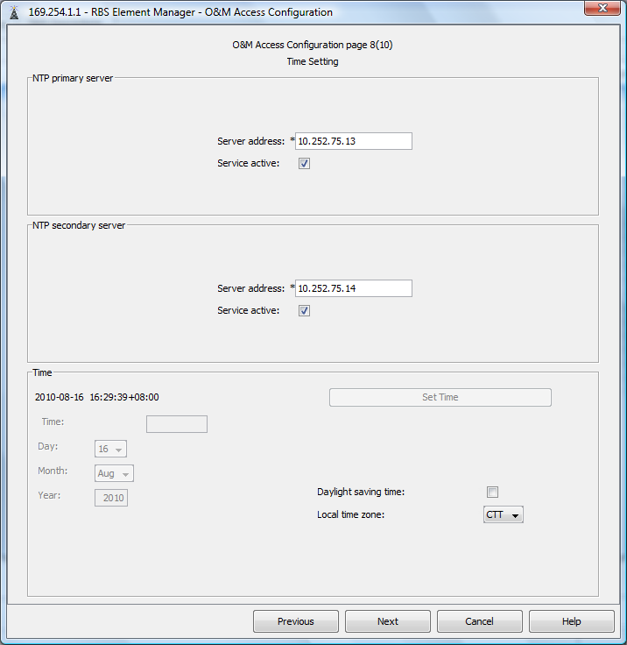

Slide 34
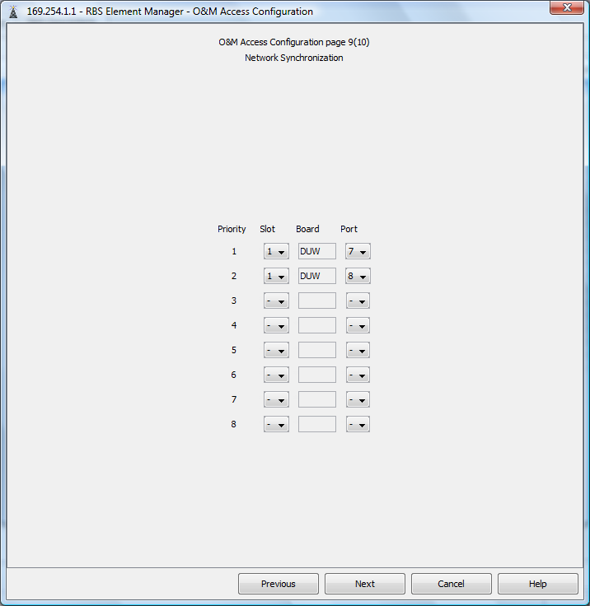

Slide 35
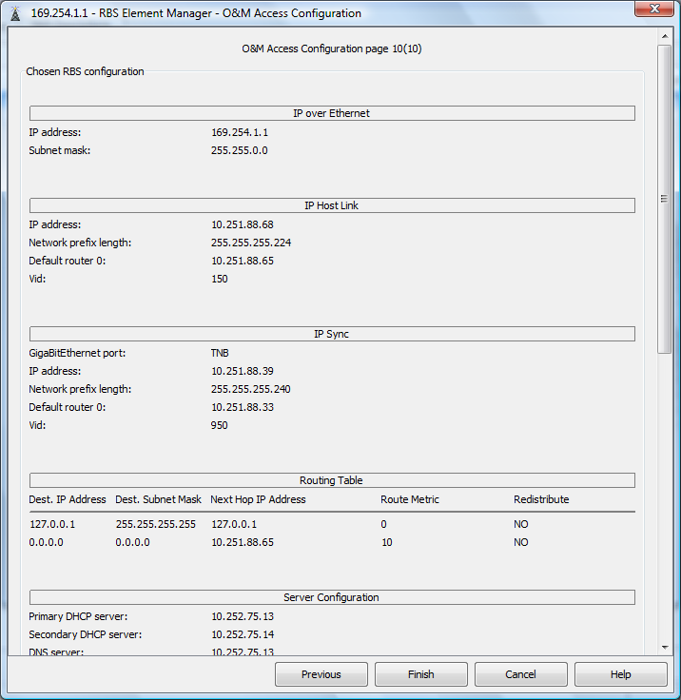

Slide 36
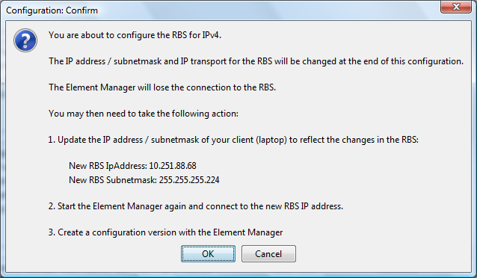

Slide 37
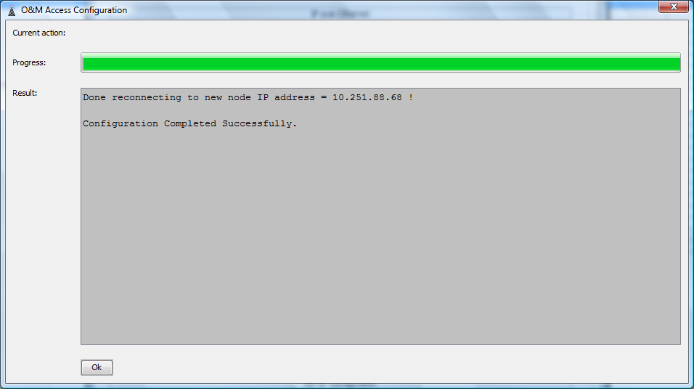

Slide 38
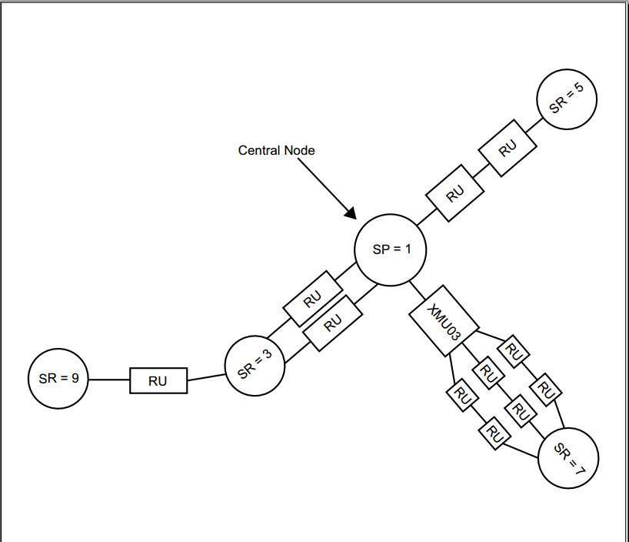
Node Group
NODE GROUP
The set of nodes that are connected to each other by shared RUs. All nodes in the group must be synchronized to each other, both in frequency and time
A Node configured to be part of a Node Group for Synchronization
SP The NGSM within the Node Group that currently is synchronizing towards one of the Node Groups external network references and is providing other NGSMs with Node Group internal synchronization. The SP can only provide synchronization to other NGSMs via Radio Configurations for Multistandard RBS.
SR An NGSM Node within the Node Group that currently is synchronizing towards one of the Node Groups internal synchronization references.

Slide 39
Basic Commands
St ru
St cell
Get radio no
Get nodeg
Stip
Get nodeip
Sts
Cvls
Cvms
Acc 0 manualrestart
Alt
Lga
Lgn

Slide 40
Common Faults
Power issue
IP changed
DUW faulty
SW error
Sync issue
Digital cable alarm
VSWR
RRU fault

