Slide 1
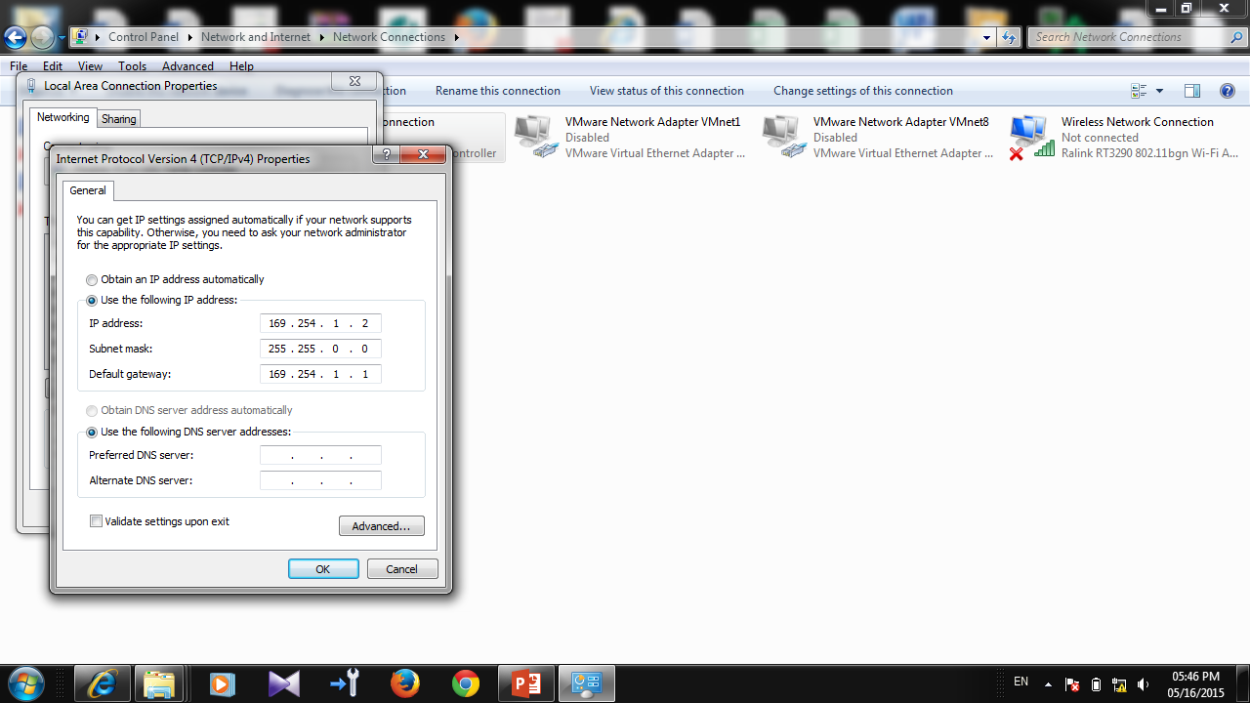
IP address and default gateway should be set
Notes:
1.آدرس IP و default gateway حتما ست شود

Slide 2
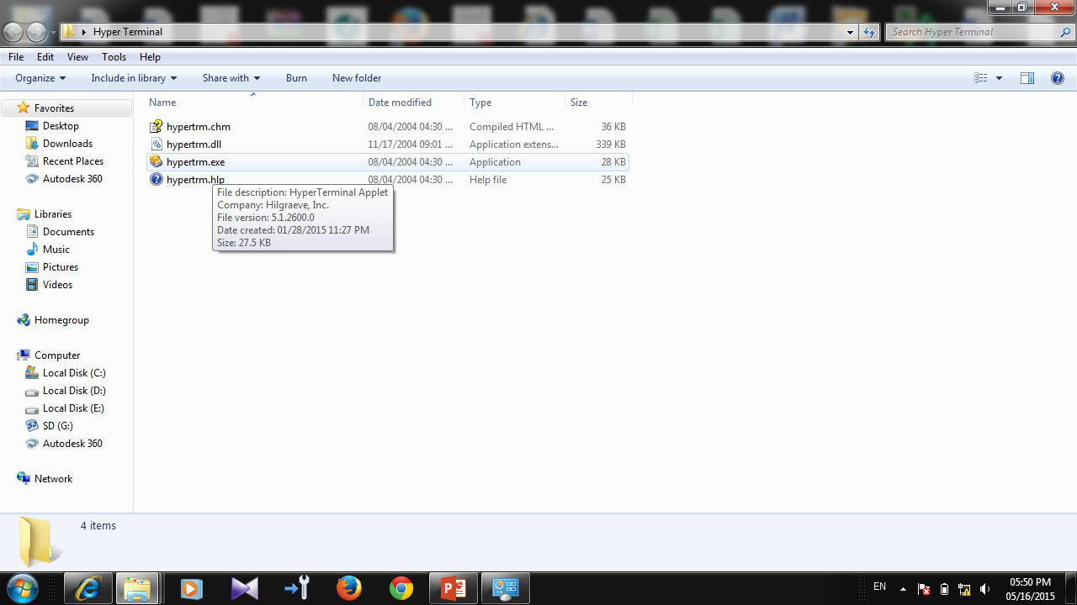
Open hyper terminal
Notes:
1.برای connect به LMT A از برنامه Hyper Terminal استفاده میشود کابل مورد استفاده دقیقا مشابه کابل DUG میباشد.

Slide 3
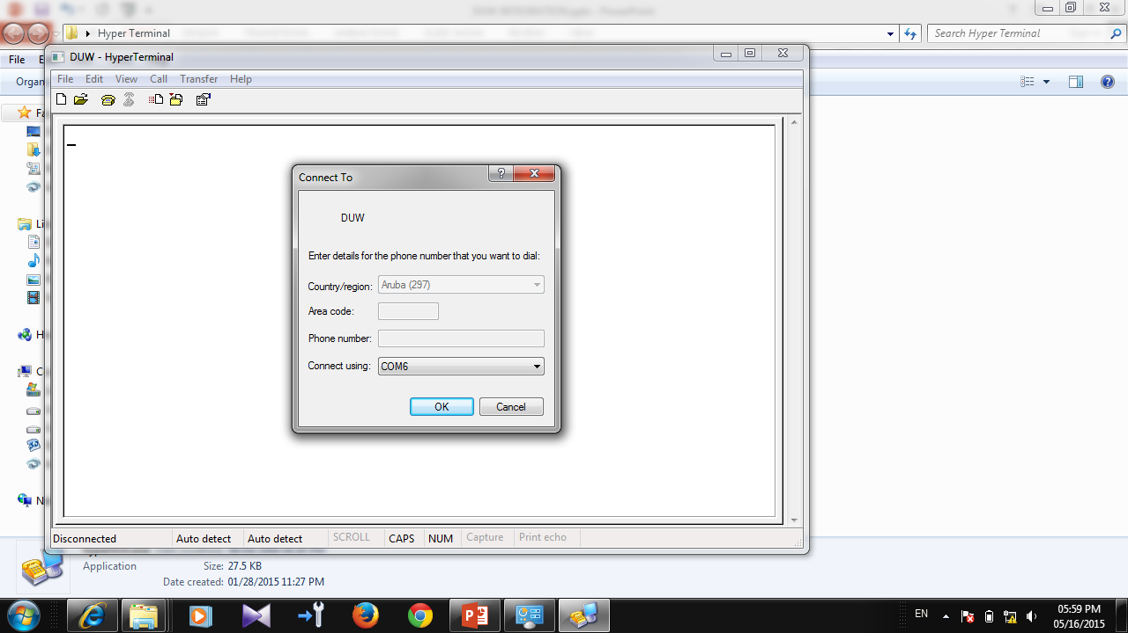
Choose the correct COM number from device manger
Click on ok
Notes:
3. کلید OK را فشار میدهیم.

Slide 4
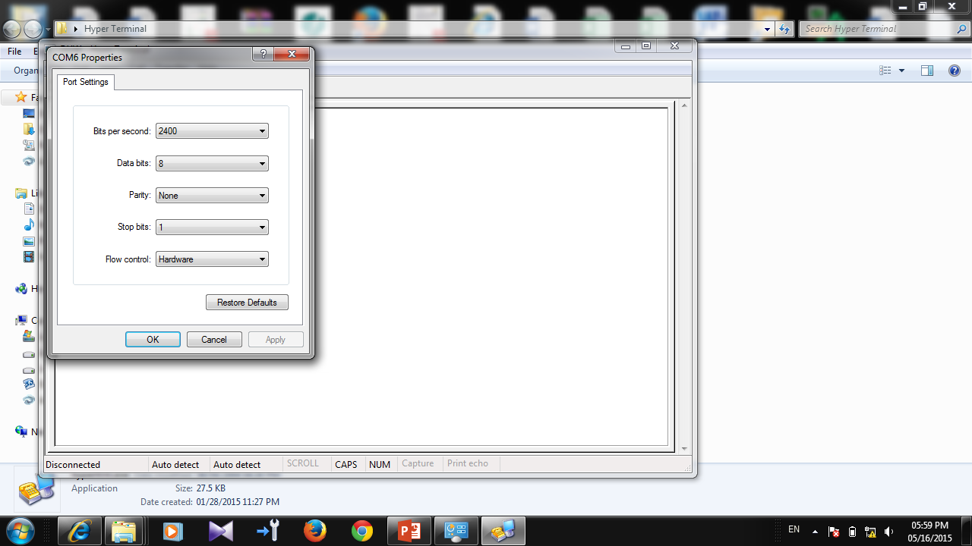
Click on Restore default
Notes:
3. COM مورد نظر را انتخاب کنید و روی کلید OK کلیک کنید.

Slide 5
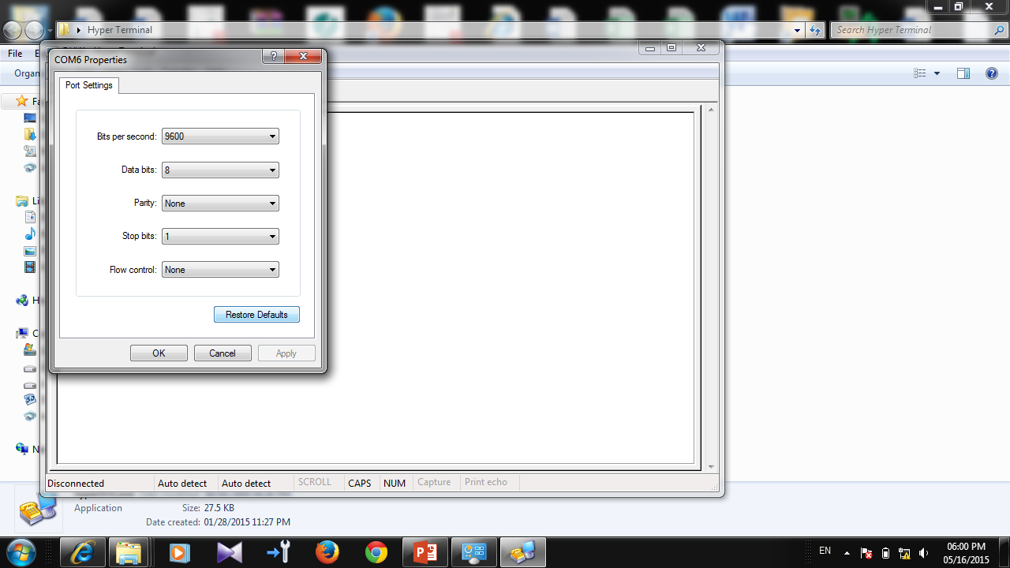
Click on ok

Slide 7
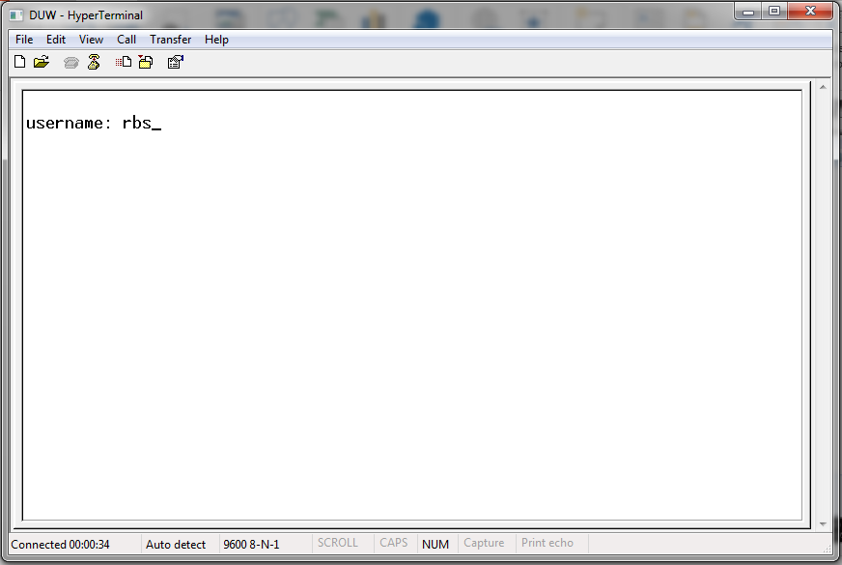
username

Slide 8
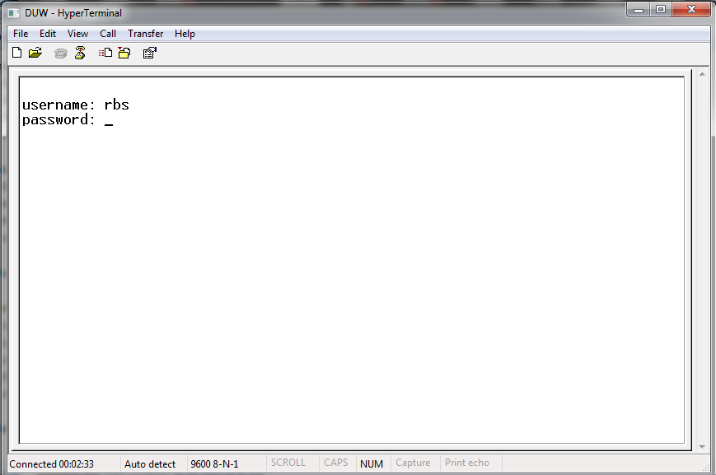
rbs
Insert rbs as password

Slide 9
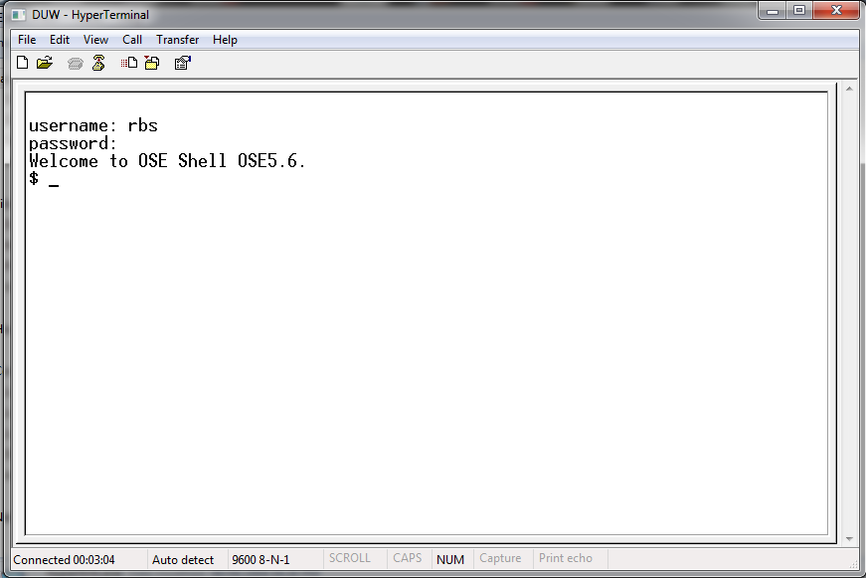

Slide 10
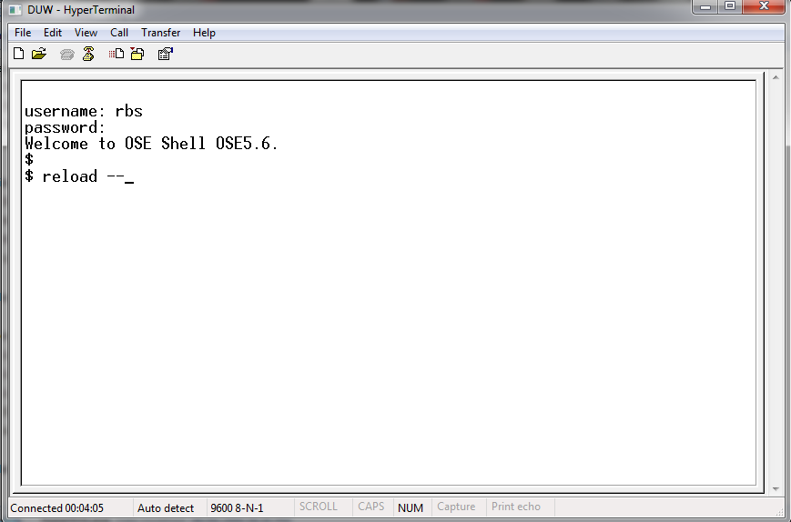
Insert reload - - to put DUW in basic mode

Slide 11
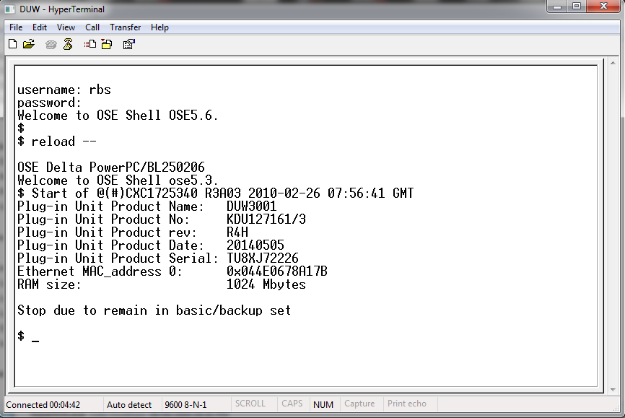
Wait until this line appears

Slide 12
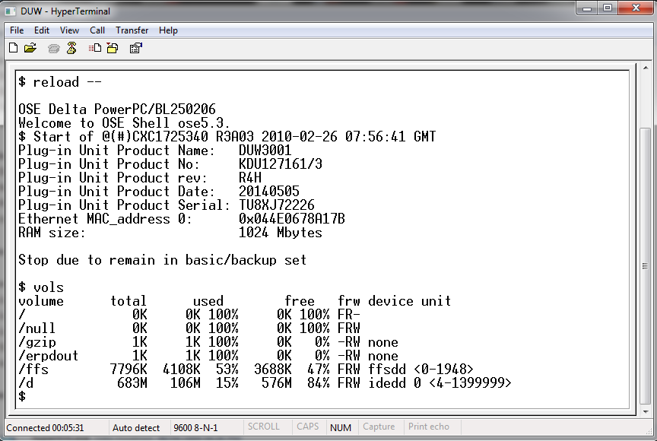
Enter vols command to show volume

Slide 13
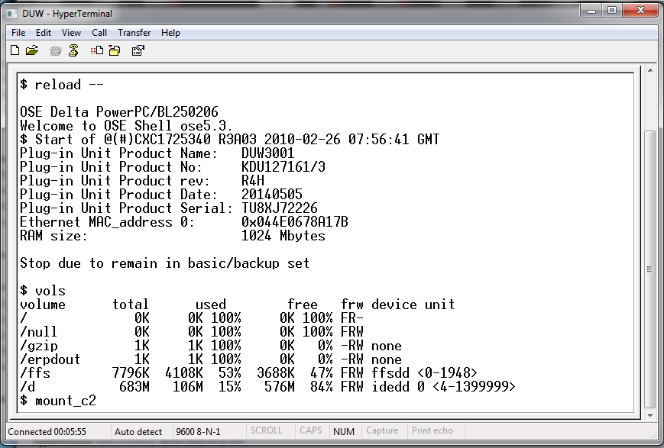
If cant see c2 type command Mount_c2

Slide 14
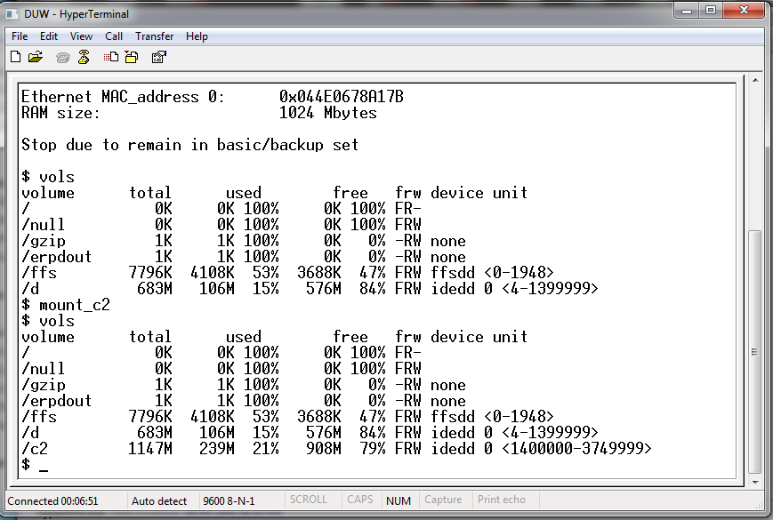
After mount you can see /c2

Slide 15
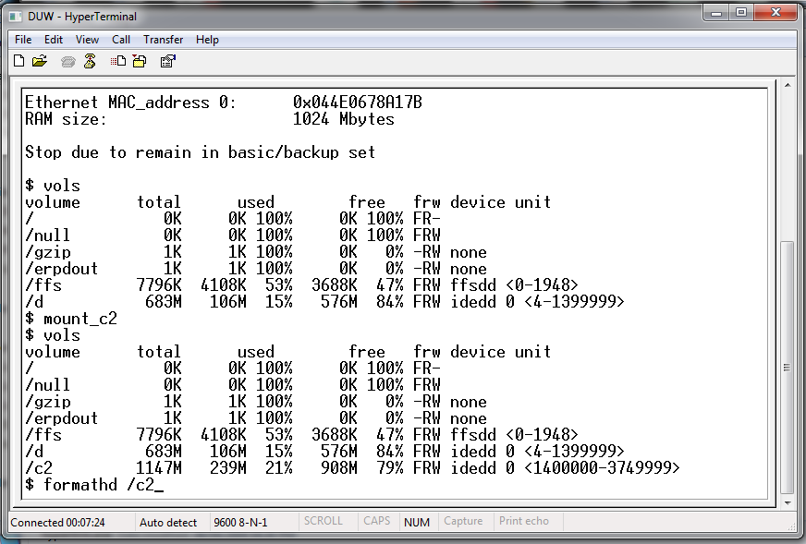
Type command formathd /c2

Slide 16
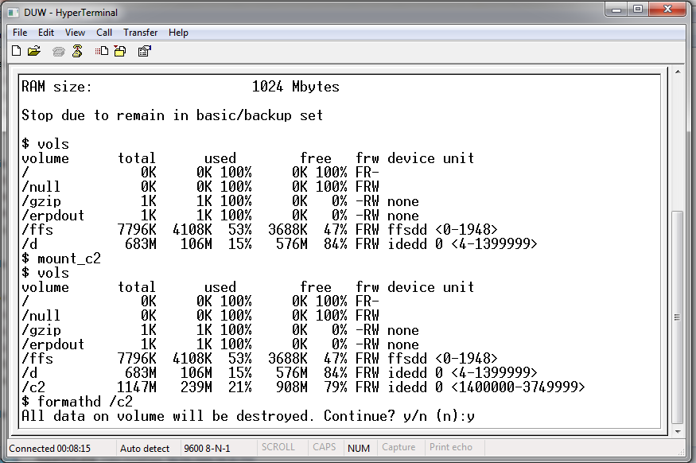
Type command Y for confirmation

Slide 17
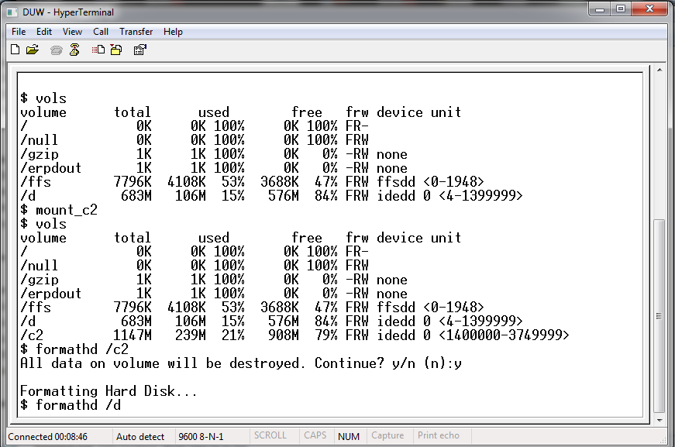
After formatting c2 format d with type command formathd /d

Slide 18
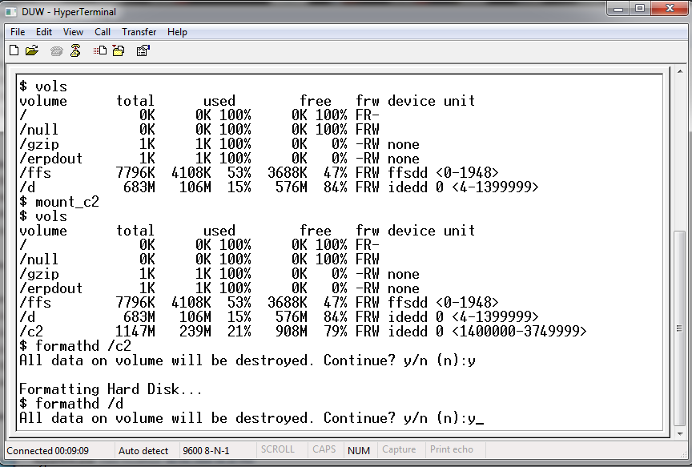
Type command Y for confirm

Slide 19
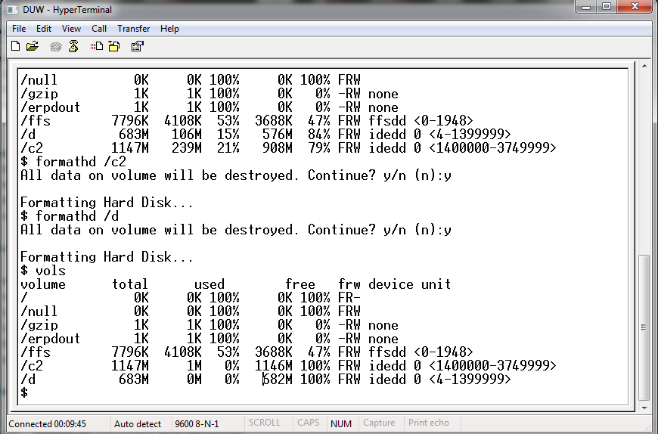
Type command vols to check c2 and d
Make sure these two number should be 0%

Slide 20
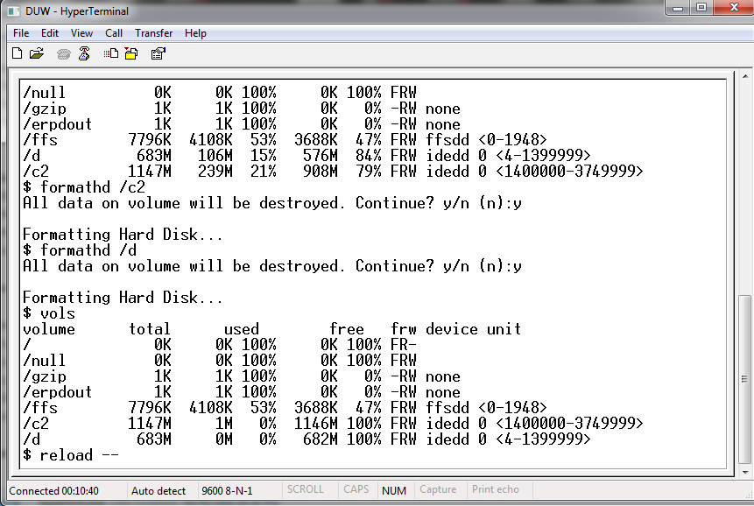
Type command reload - -

Slide 21
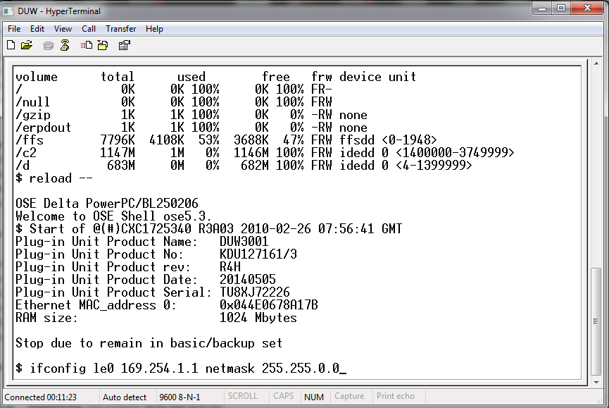
Set ip by command ifconfig for le0 adapter

Slide 22
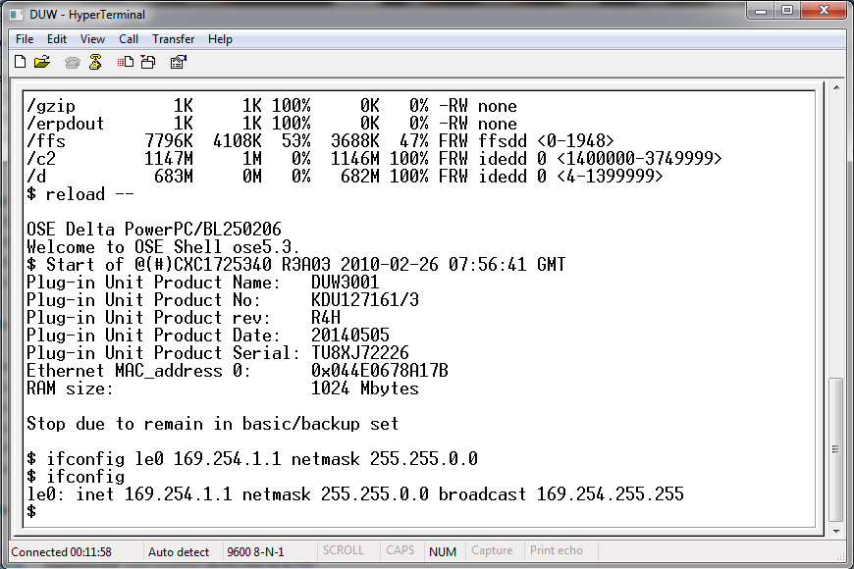
With Ifconfig check Ip

Slide 23
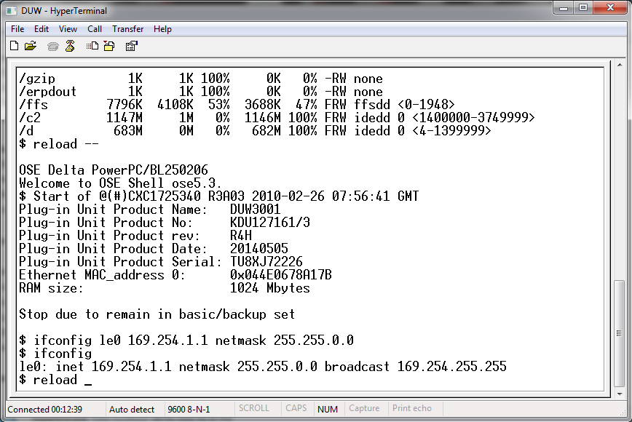
Type command reload

Slide 24
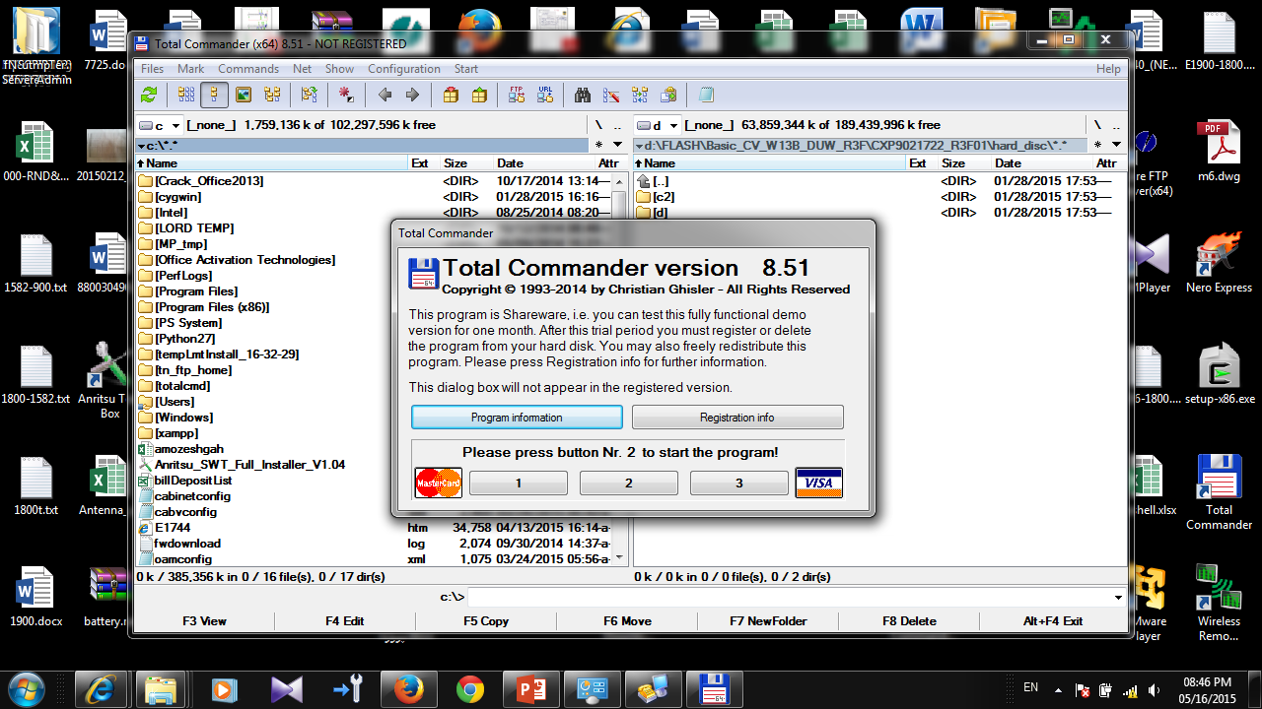
Open total commander

Slide 25
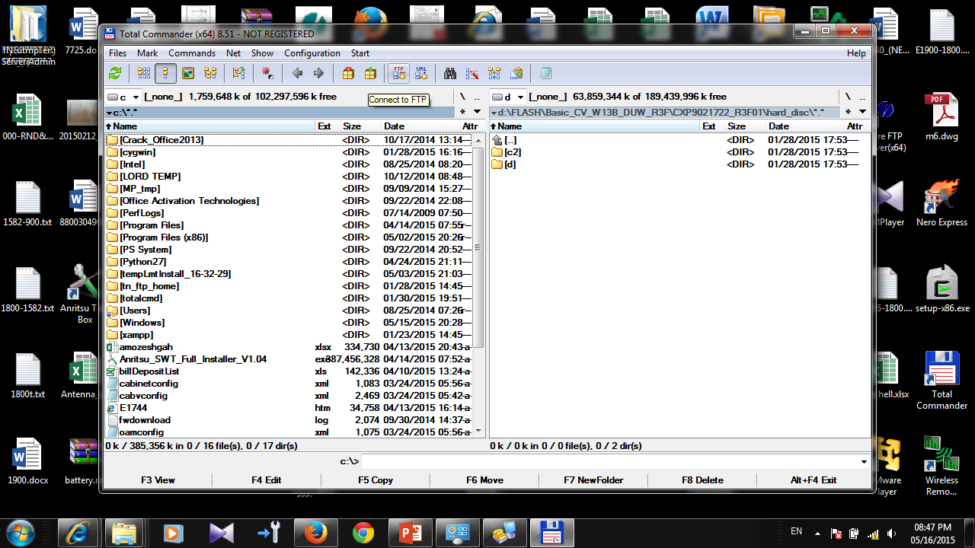
Click on this button to connect to DUW

Slide 26
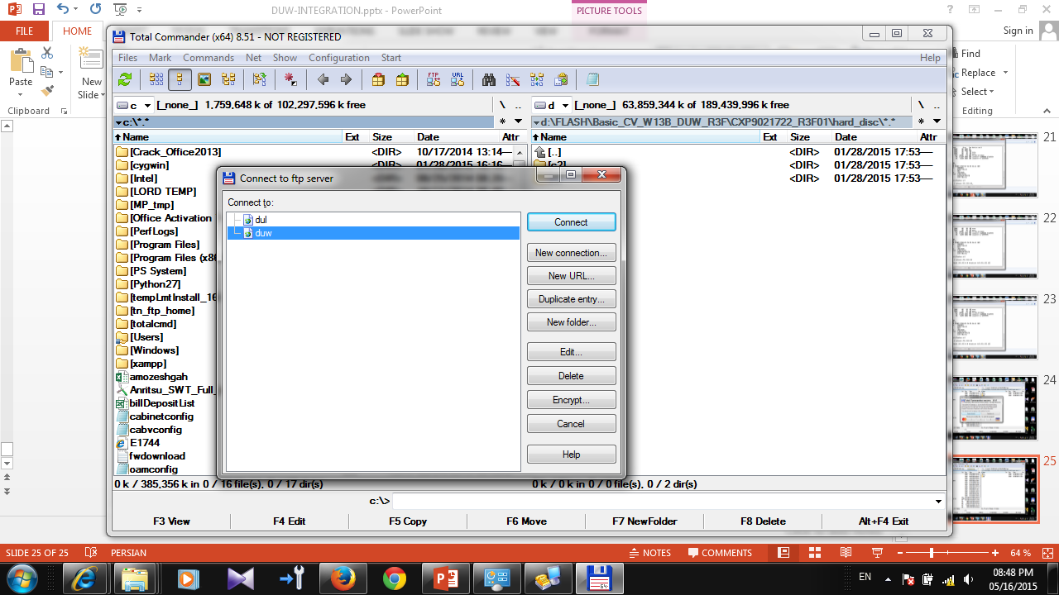

Slide 27
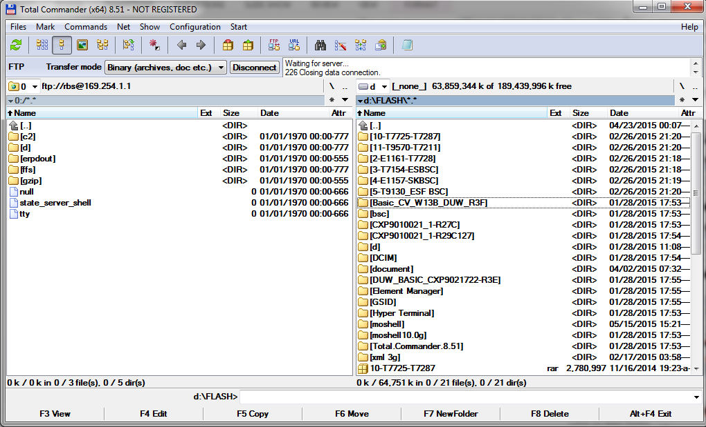
DUW DRIVER
YOUR COMPUTER DRIVER
SELECT basic package

Slide 28
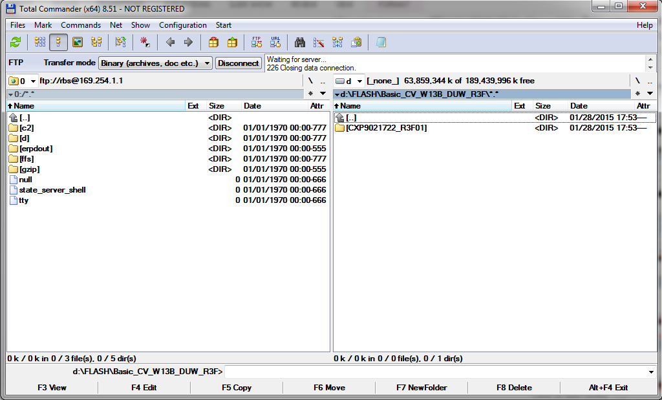
Select R3F01

Slide 29
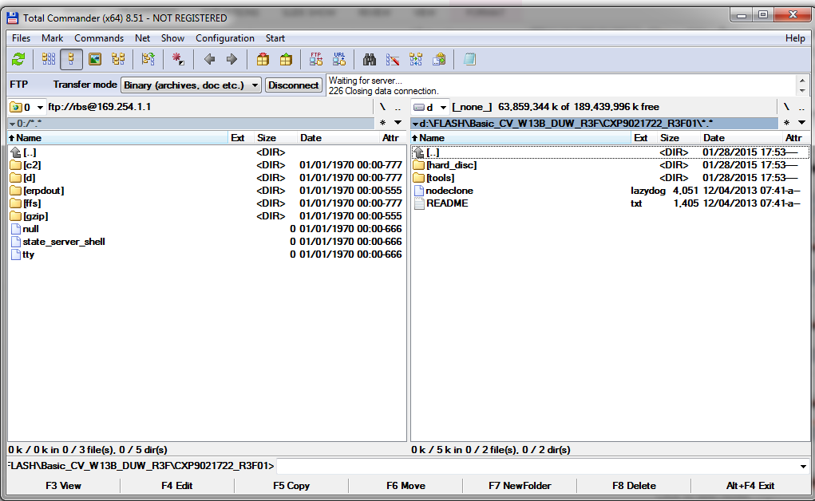
Select [hard_disk]

Slide 30
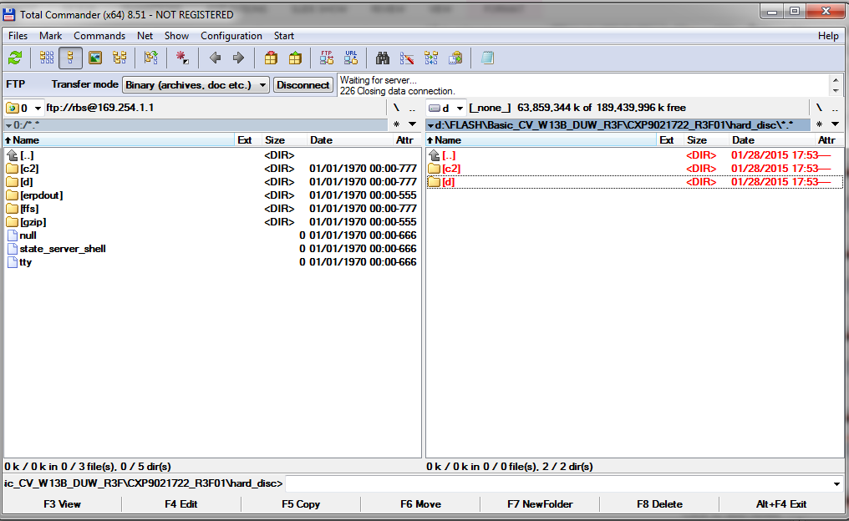
Select c2 and d
Press F5 for transferring data to DUW

Slide 31
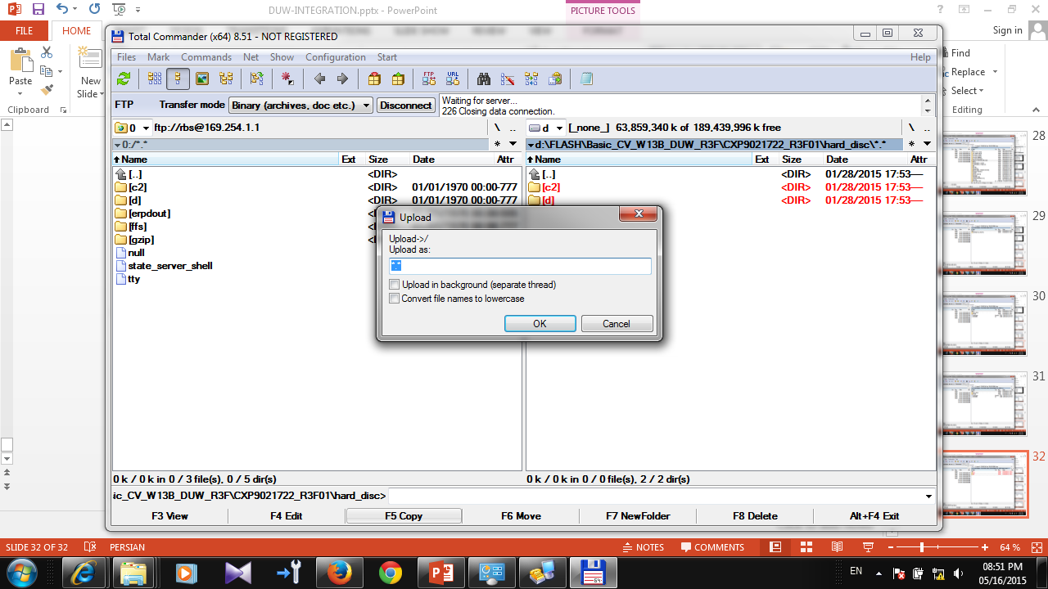
Click on ok

Slide 32
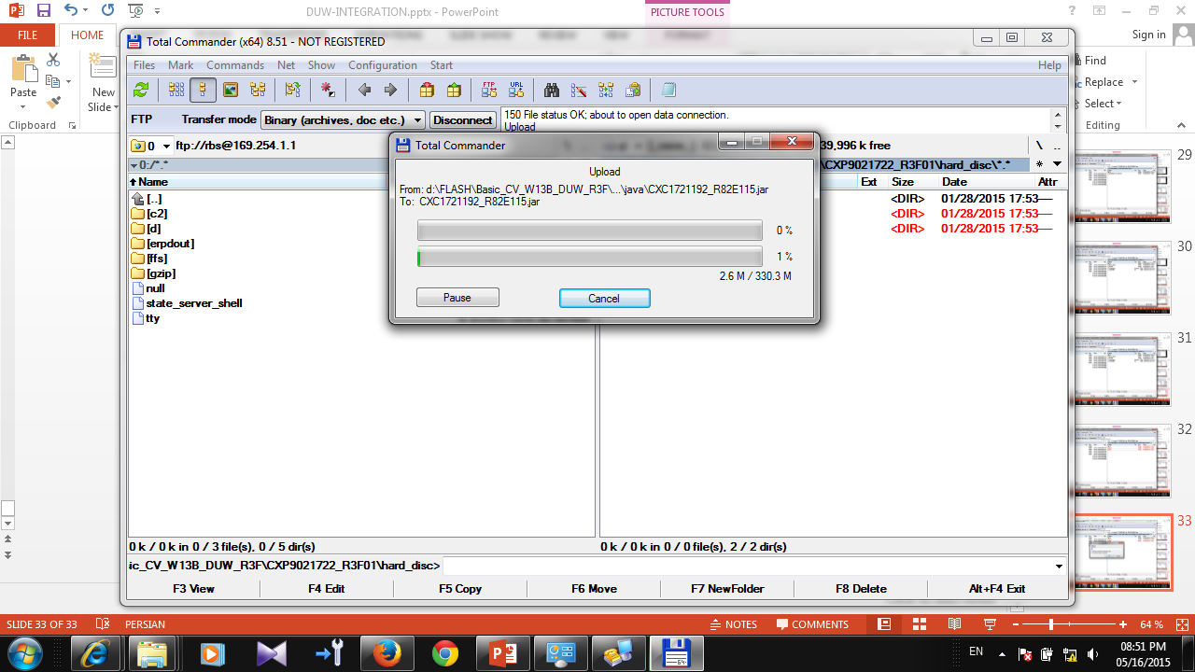

Slide 33
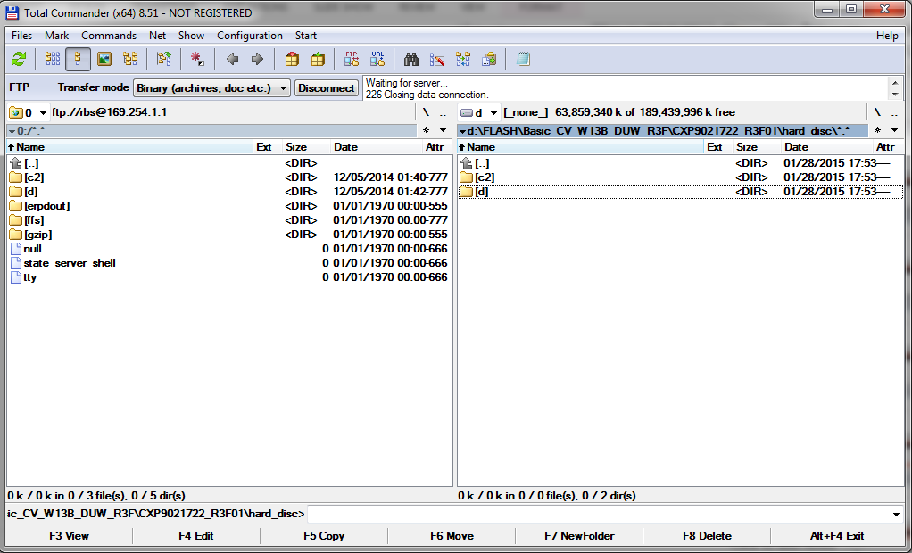

Slide 34
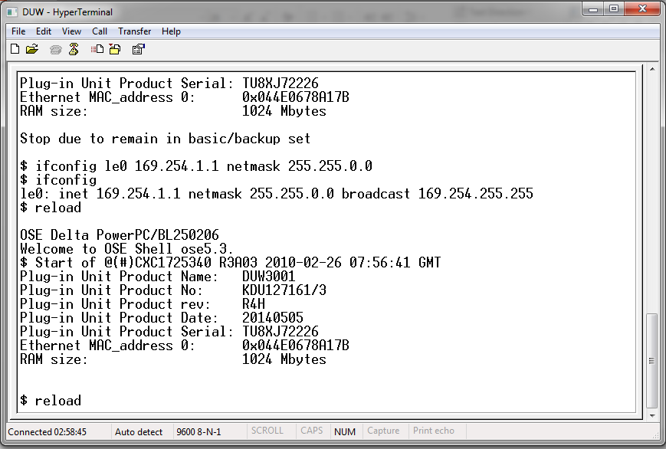
After transfer finished Reload DUW
DON’T CONFUSE RELOAD WITH RELOAD --

Slide 35
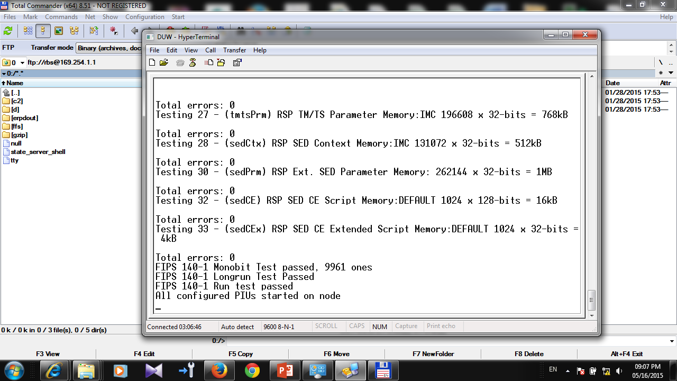
Wait 15 minute to see this line after that connect
With element manager

Slide 36
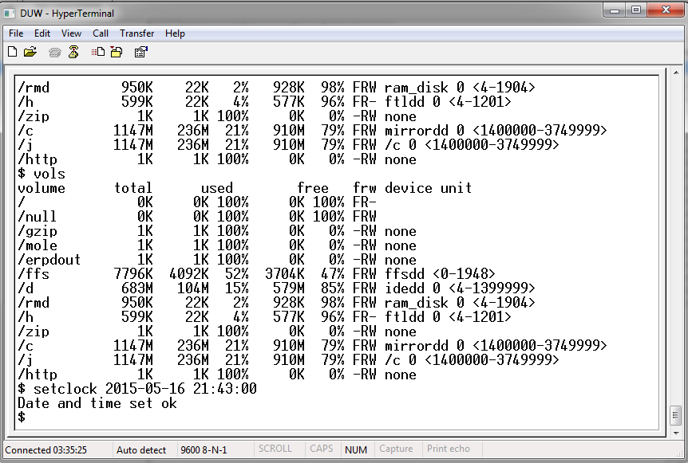
Set time with setclock command

