Slide 1
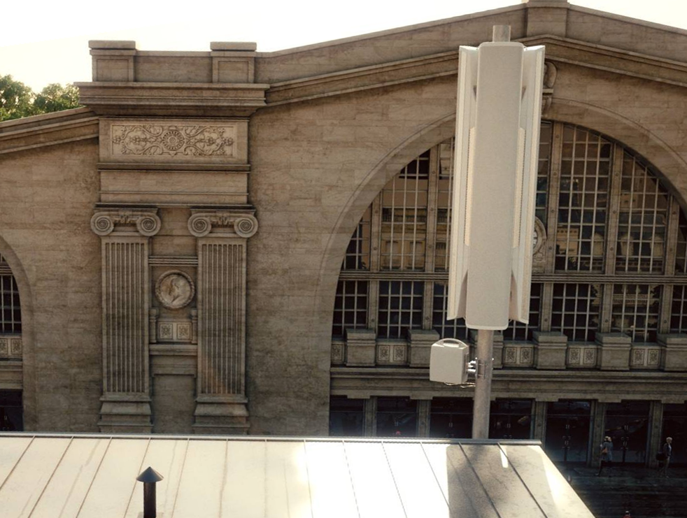

Slide 2
Notes:
Connect to the DUU XX band

Slide 4
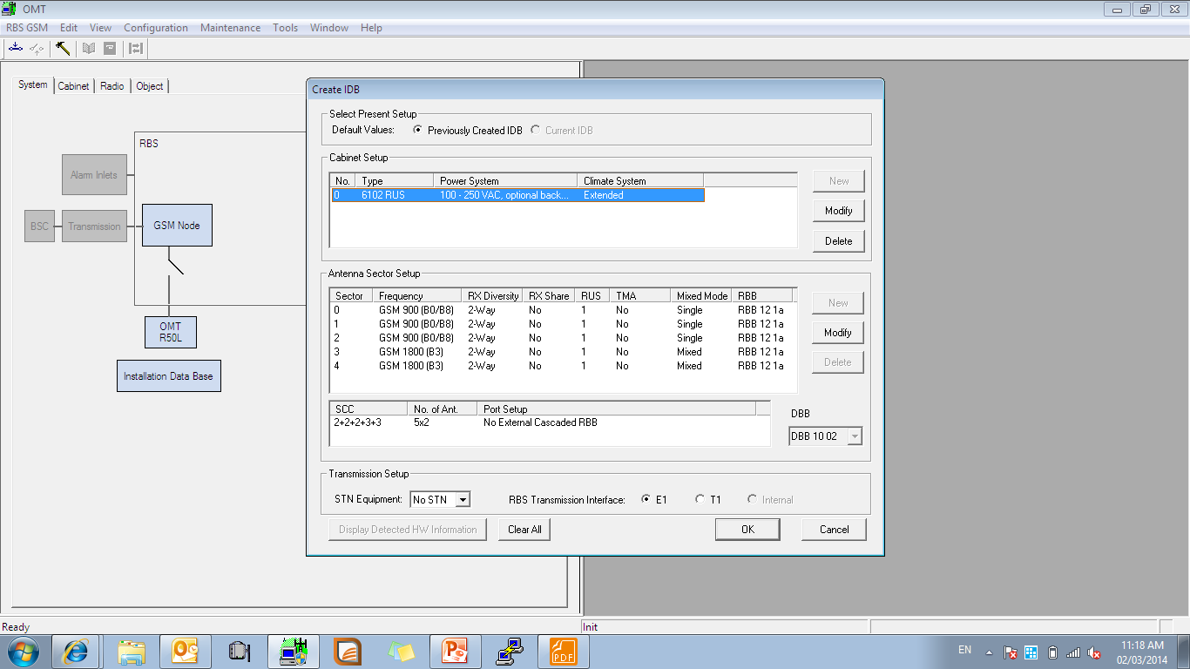

Slide 5
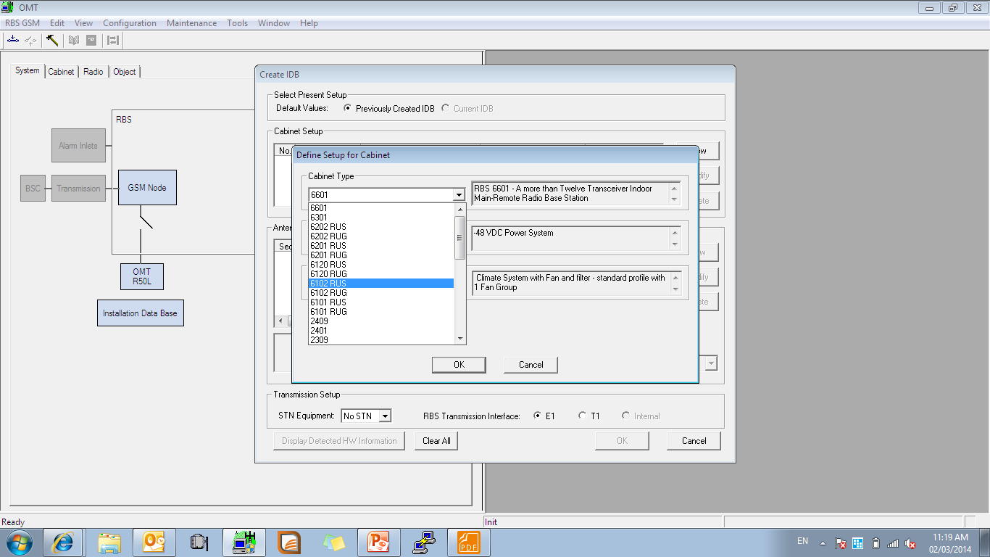

Slide 6
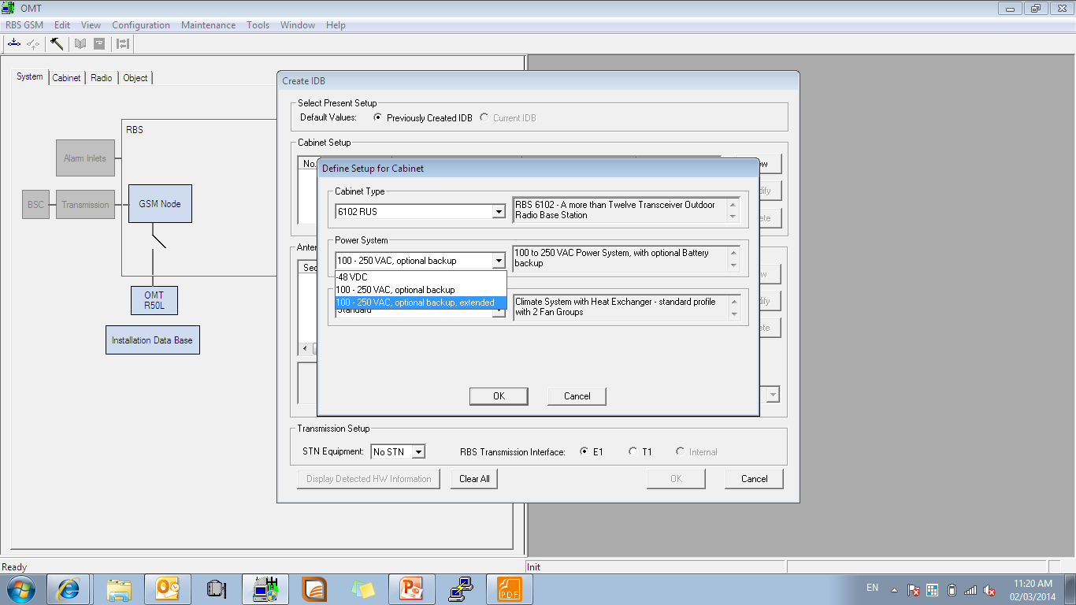

Slide 7
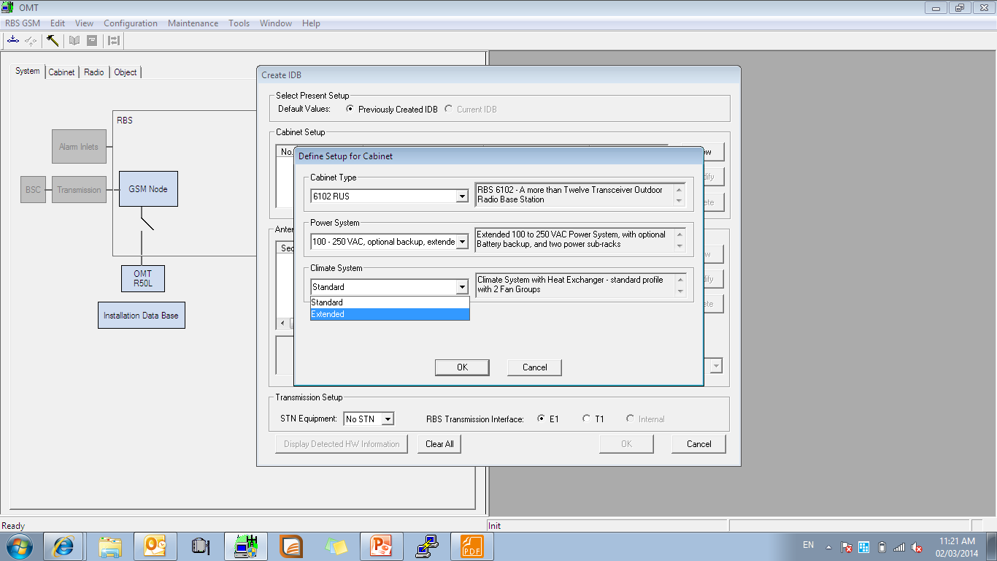

Slide 8
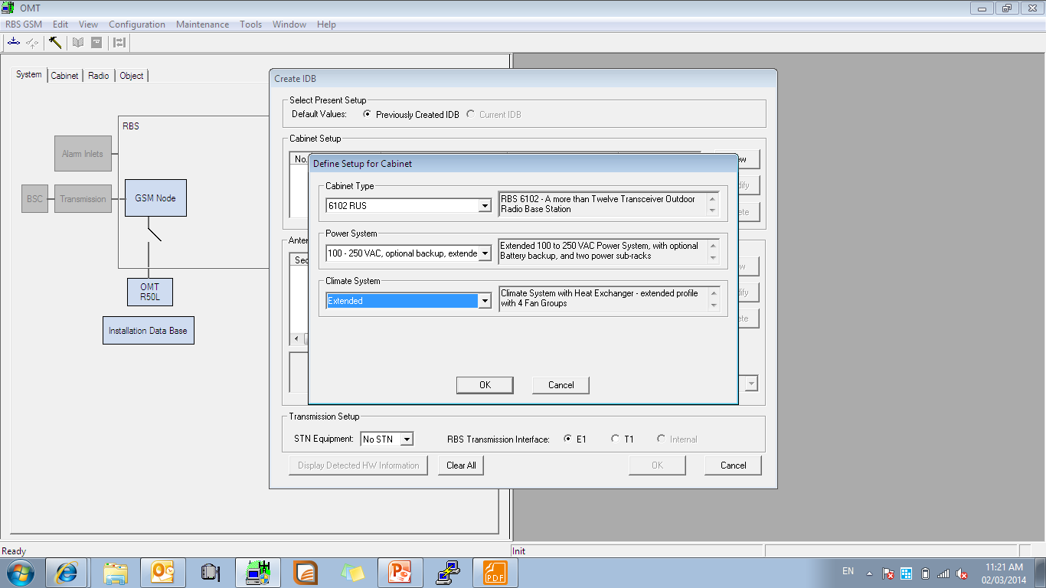

Slide 9
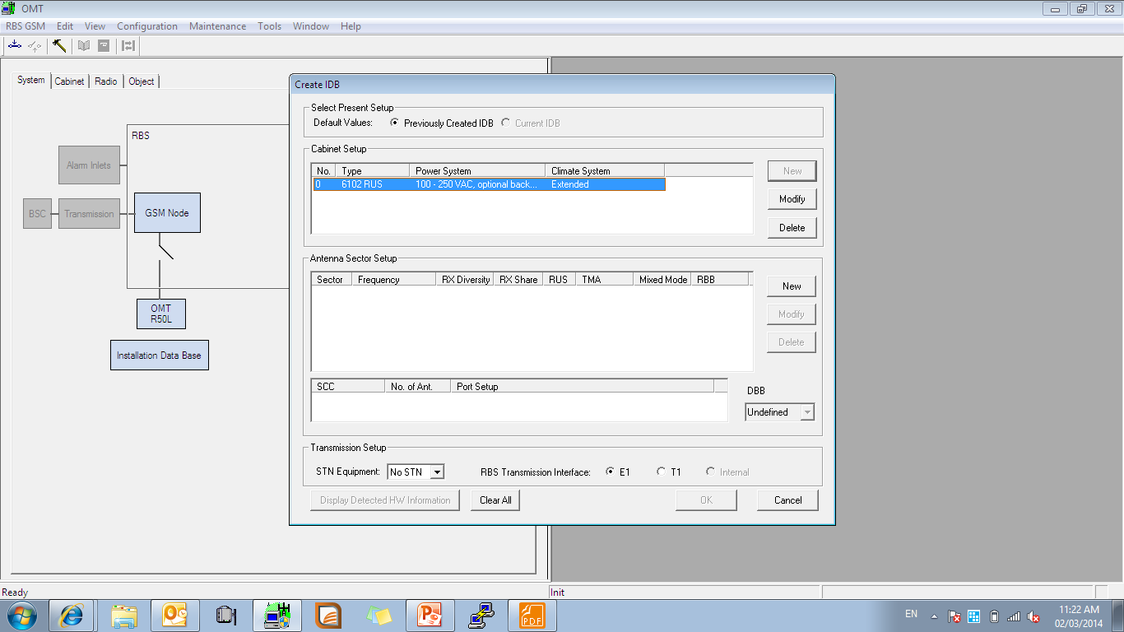

Slide 10
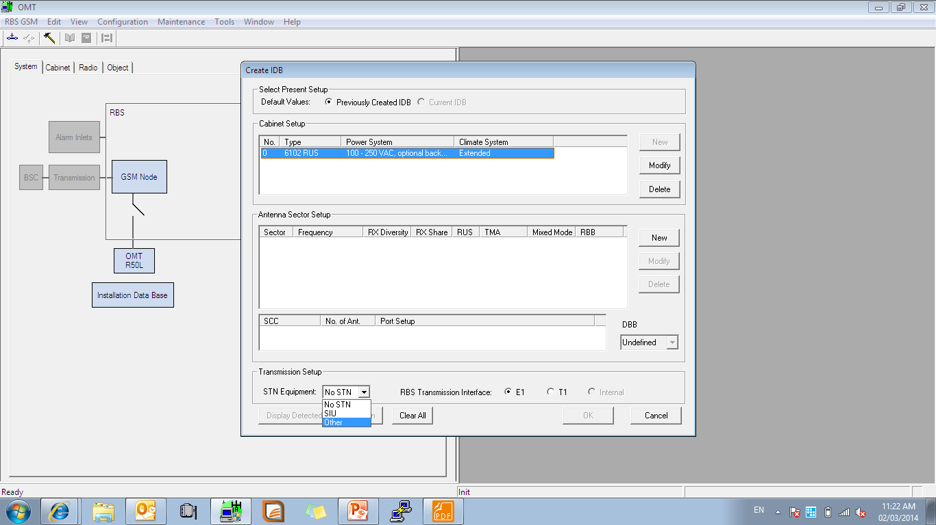

Slide 11
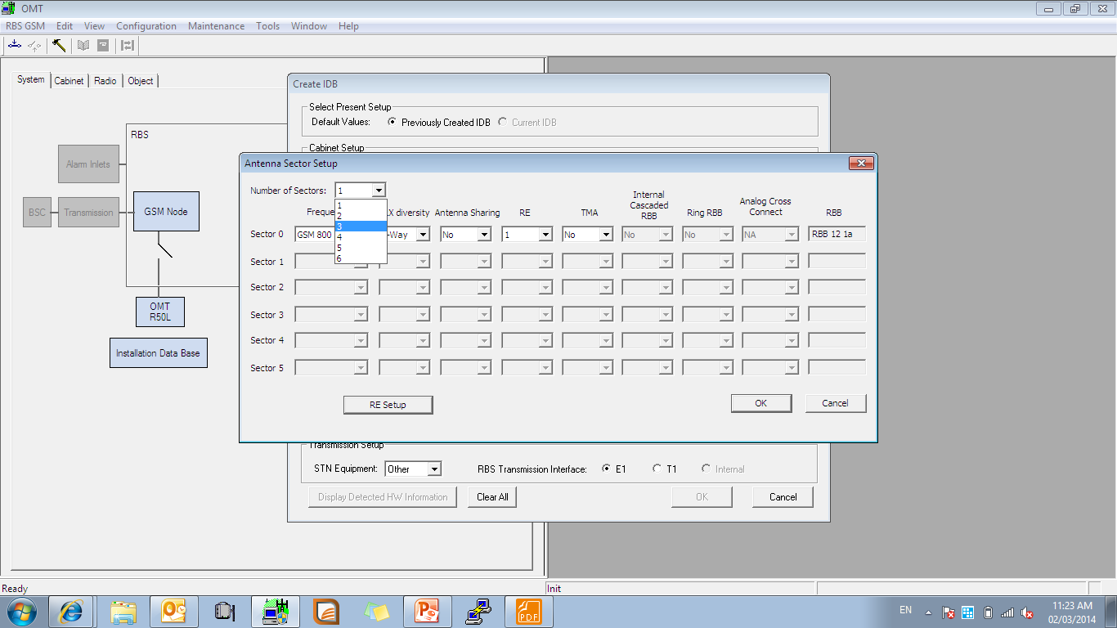
Notes:
Select number of RUS

Slide 12
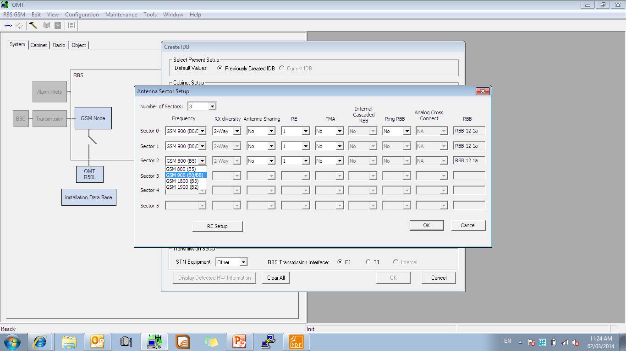
Notes:
Select your RUS Band

Slide 13
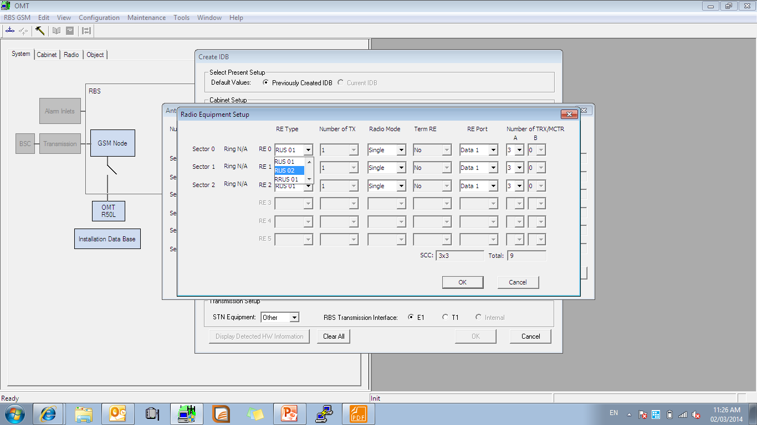
Notes:
Select your RUS type

Slide 14
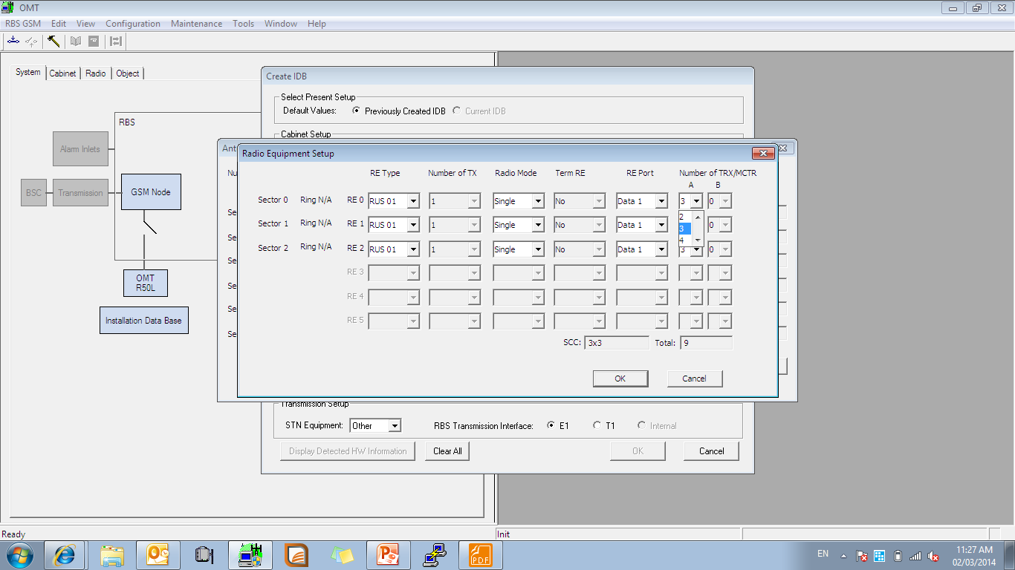
Notes:
Select number of Trx according to the SID ( configuration of site)

Slide 15
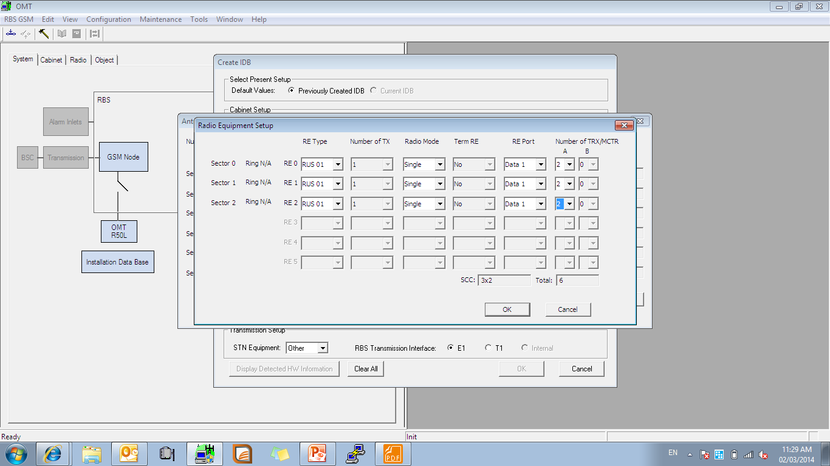
Notes:
For example your configuration is: 2+2+2 for 9 band

Slide 16
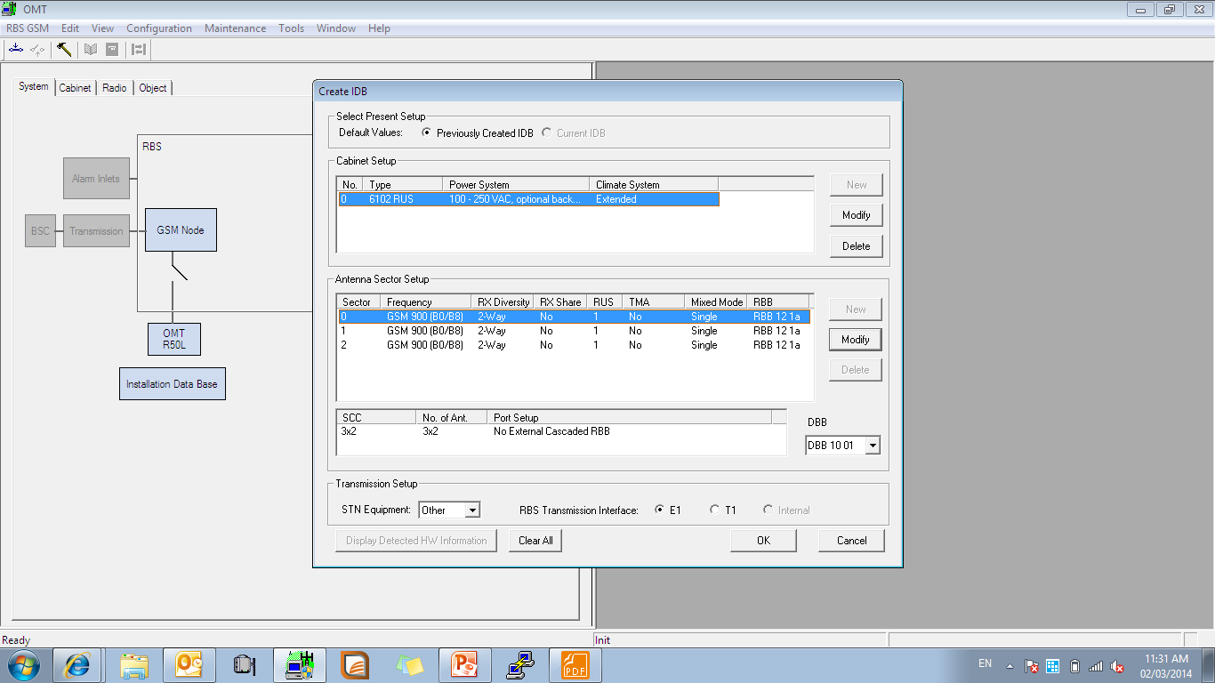

Slide 17
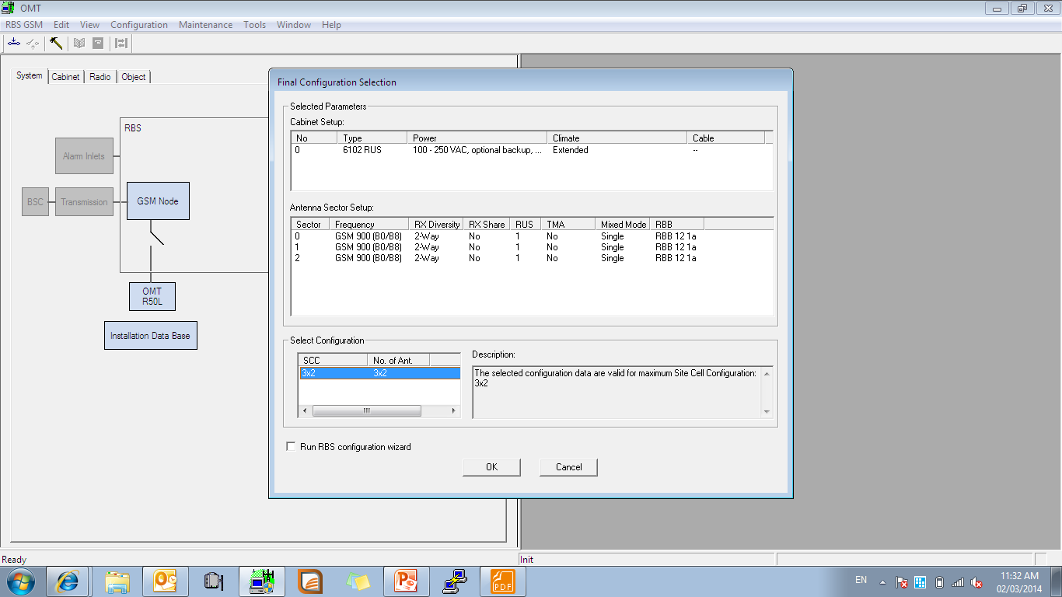

Slide 18
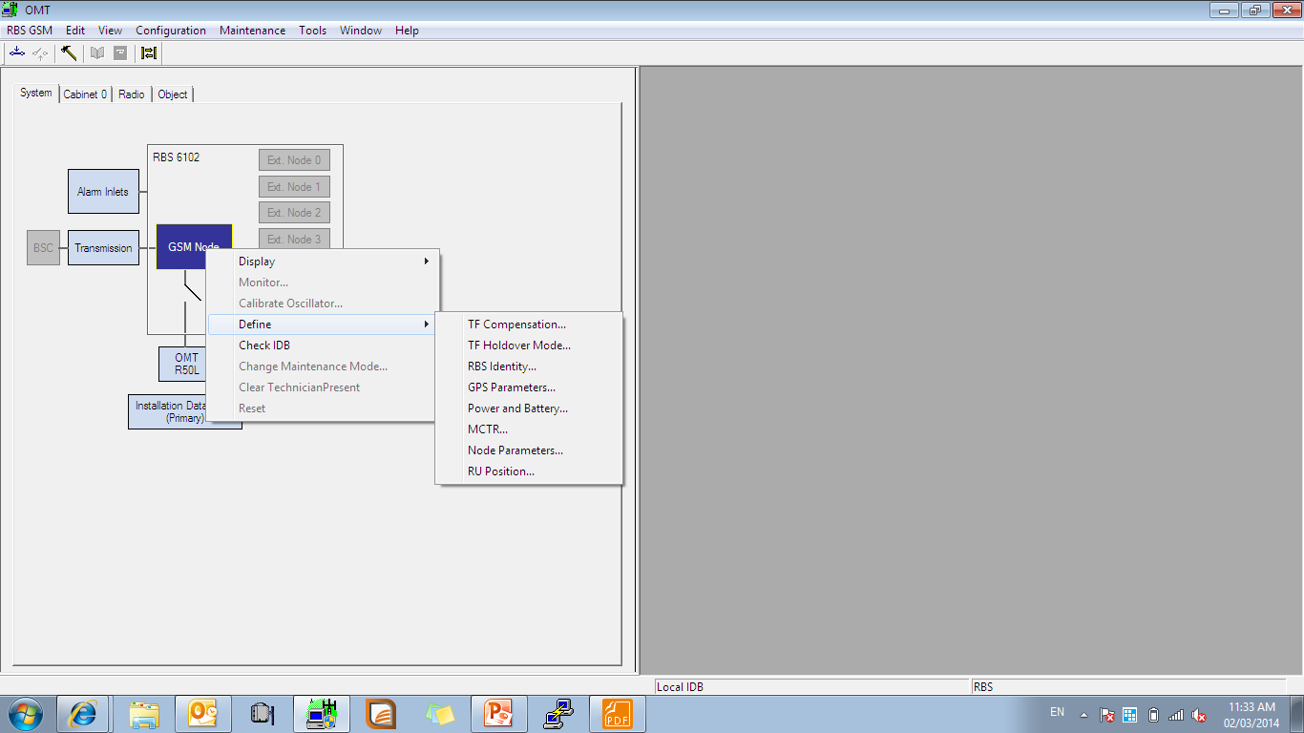
Notes:
Right click to GSM Node ----define ---- and set item you need

Slide 19
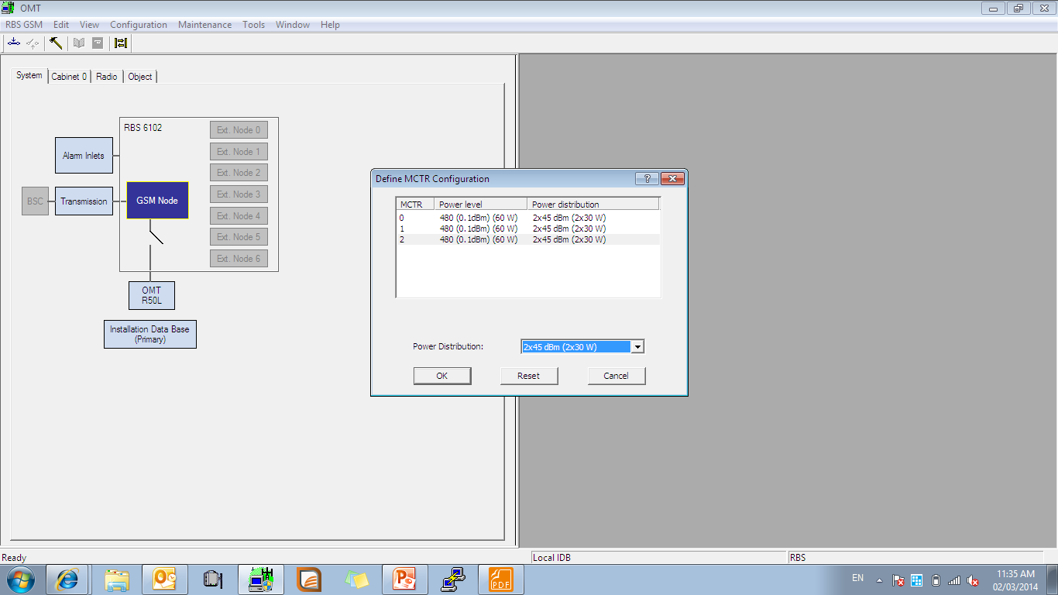
Notes:
MCTR must set according to BSC

Slide 20
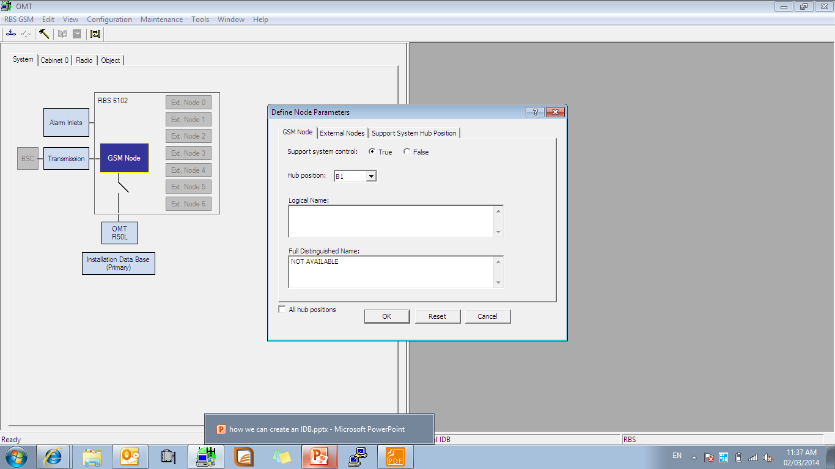
Notes:
Set an node parameters

Slide 21
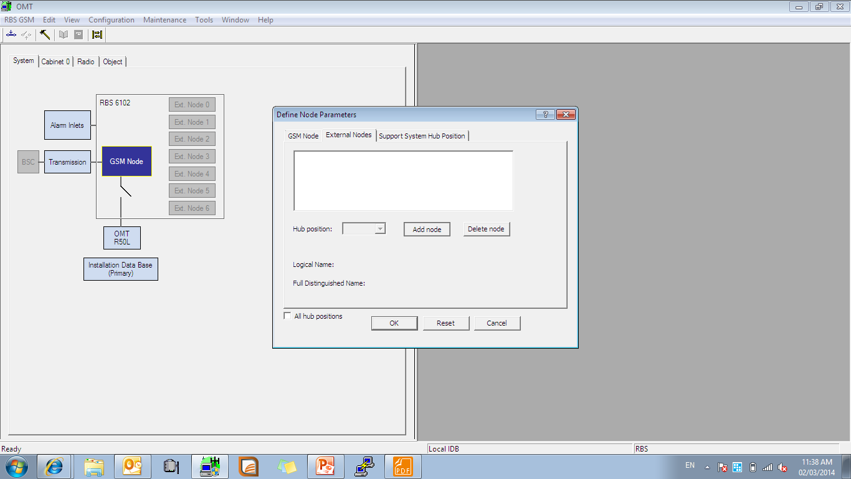
Notes:
Go to external nod and add node

Slide 22
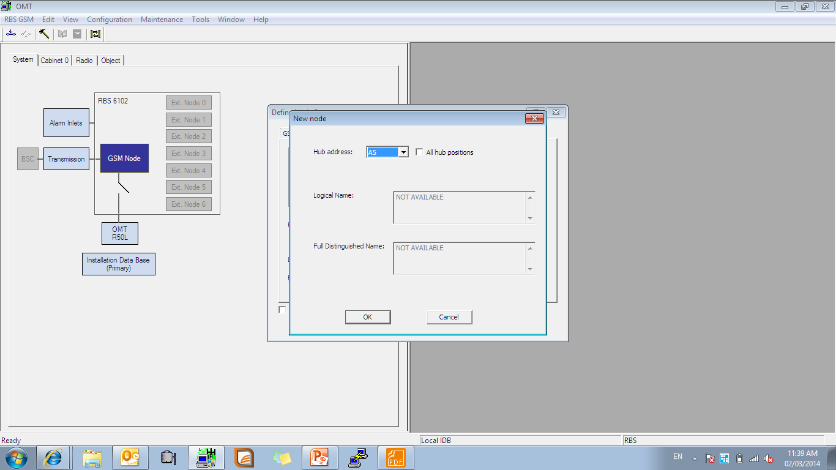
Notes:
Set an hub address according to the plan

Slide 23
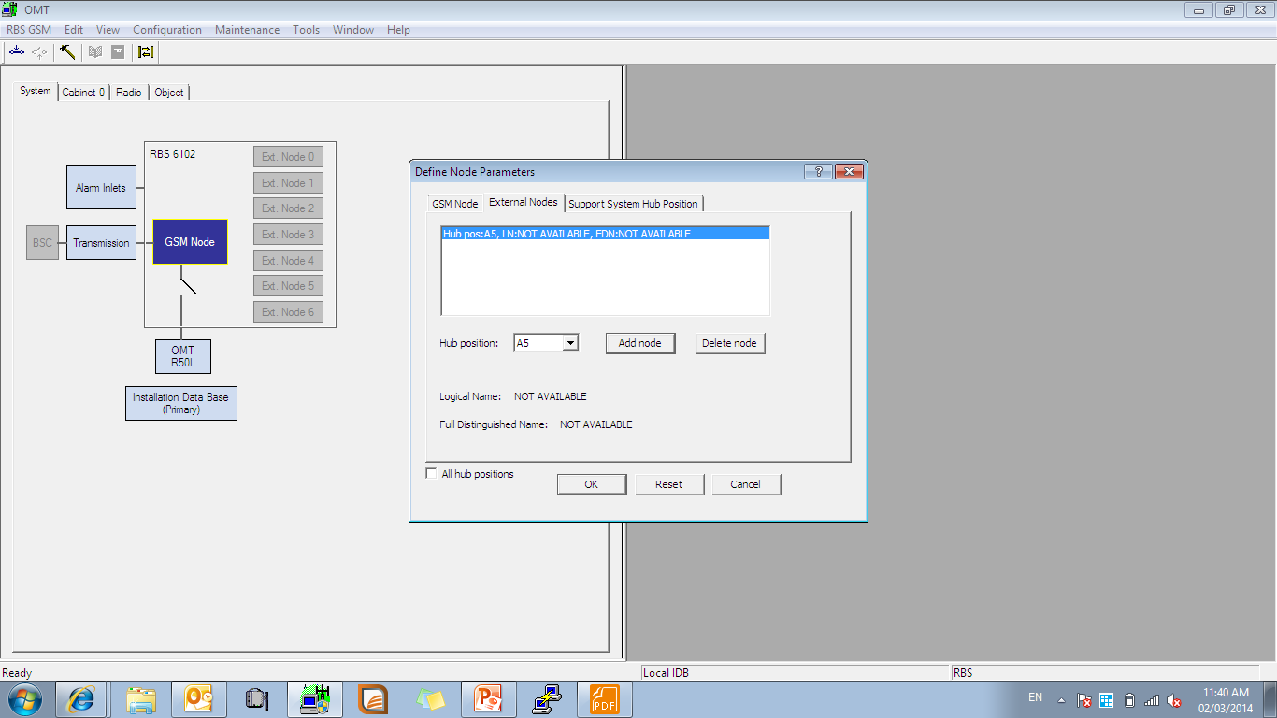
Notes:
You add an nod click ok and continue

Slide 24
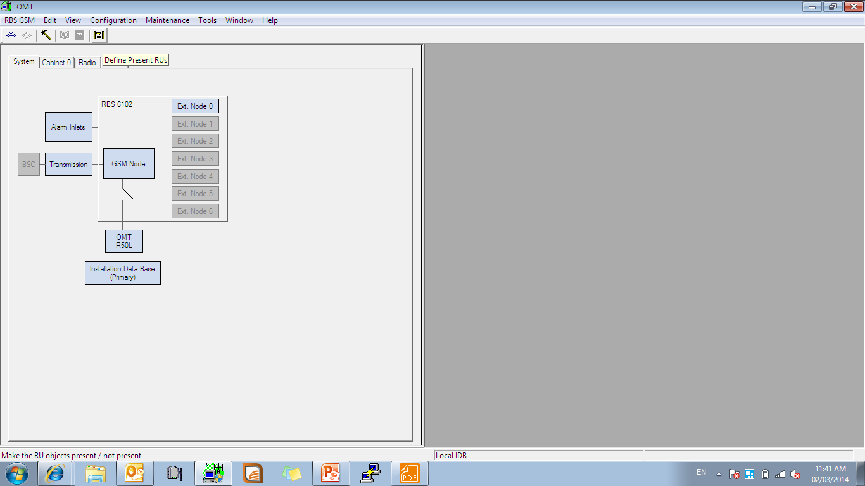
Notes:
Define present your device (just present device you need)

Slide 25
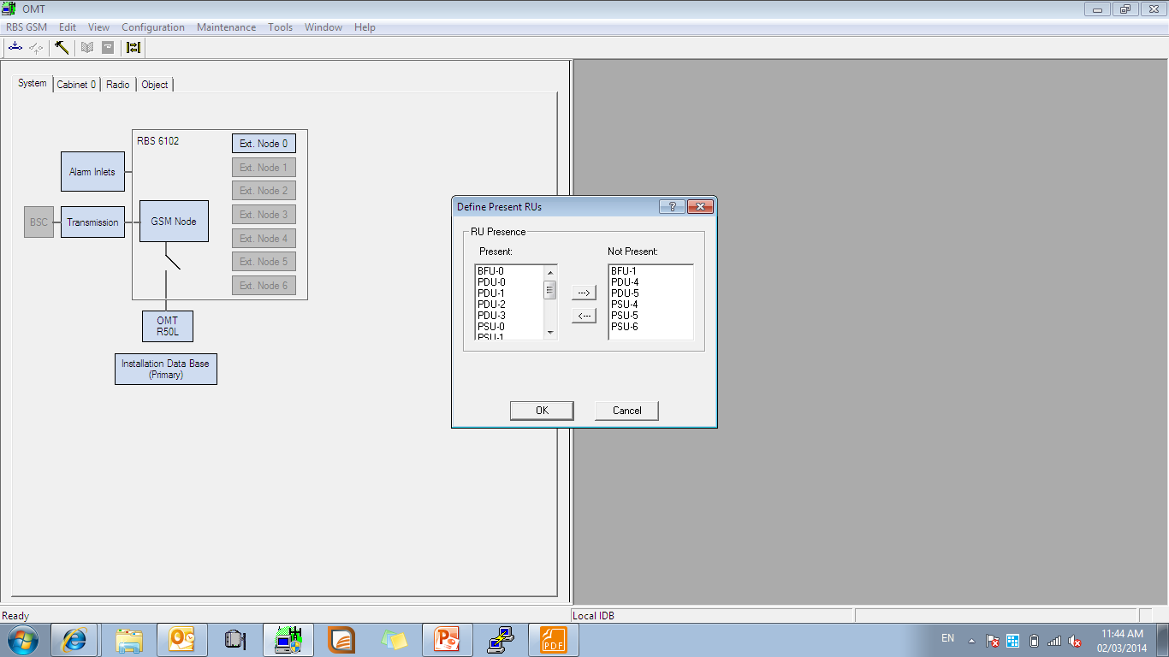

Slide 27
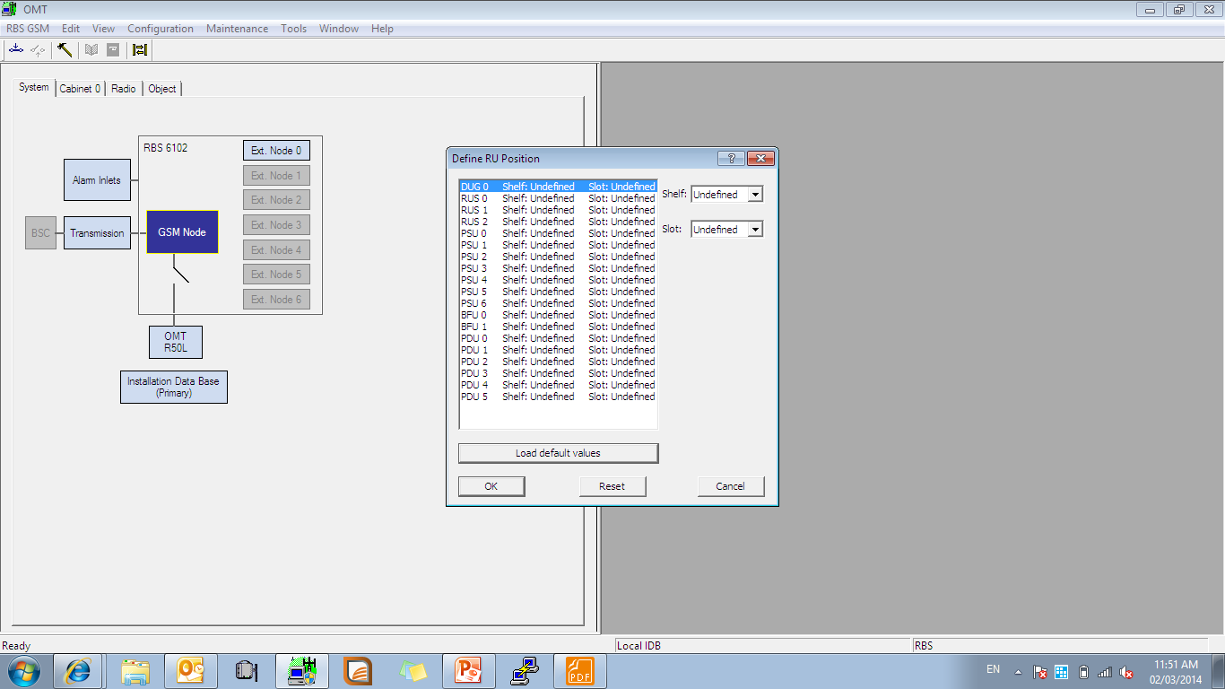

Slide 28
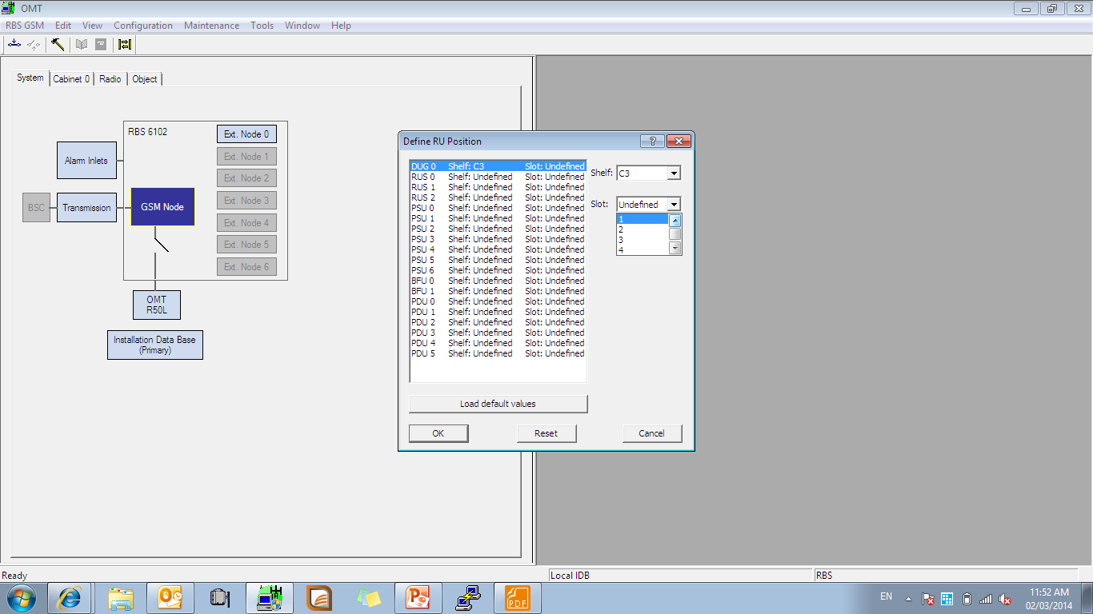
Notes:
Select shelf and slot device

Slide 29
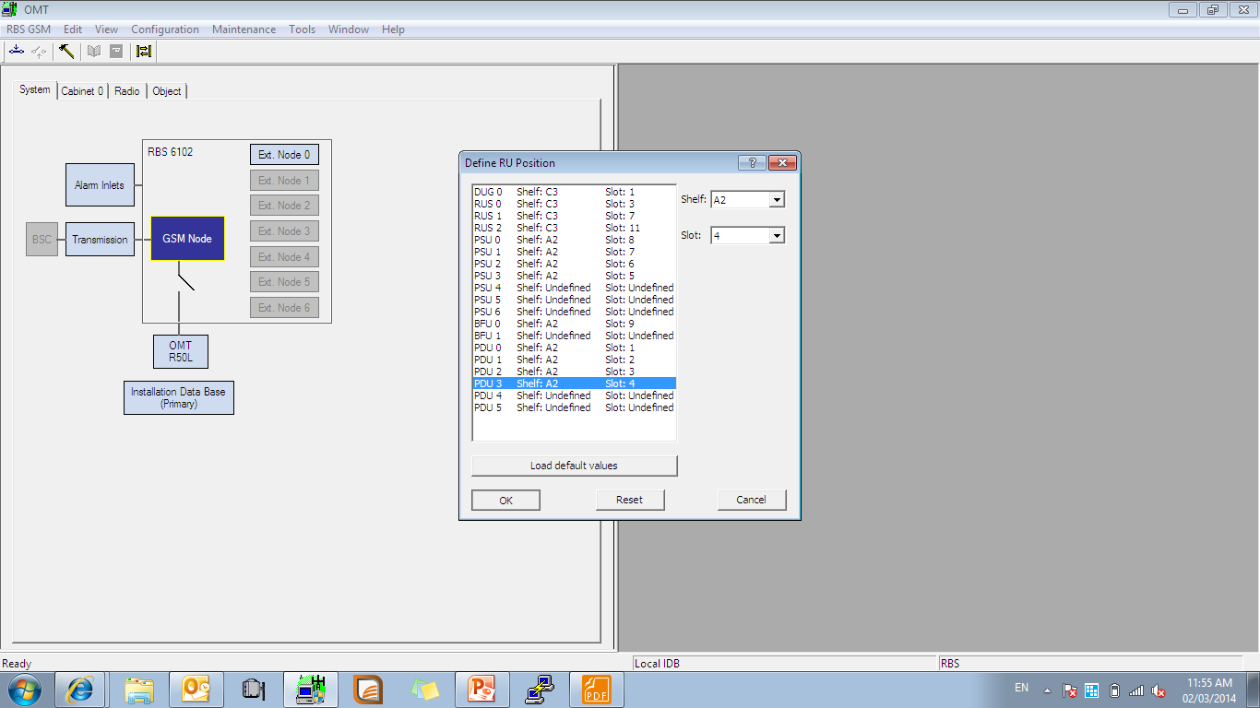

Slide 30
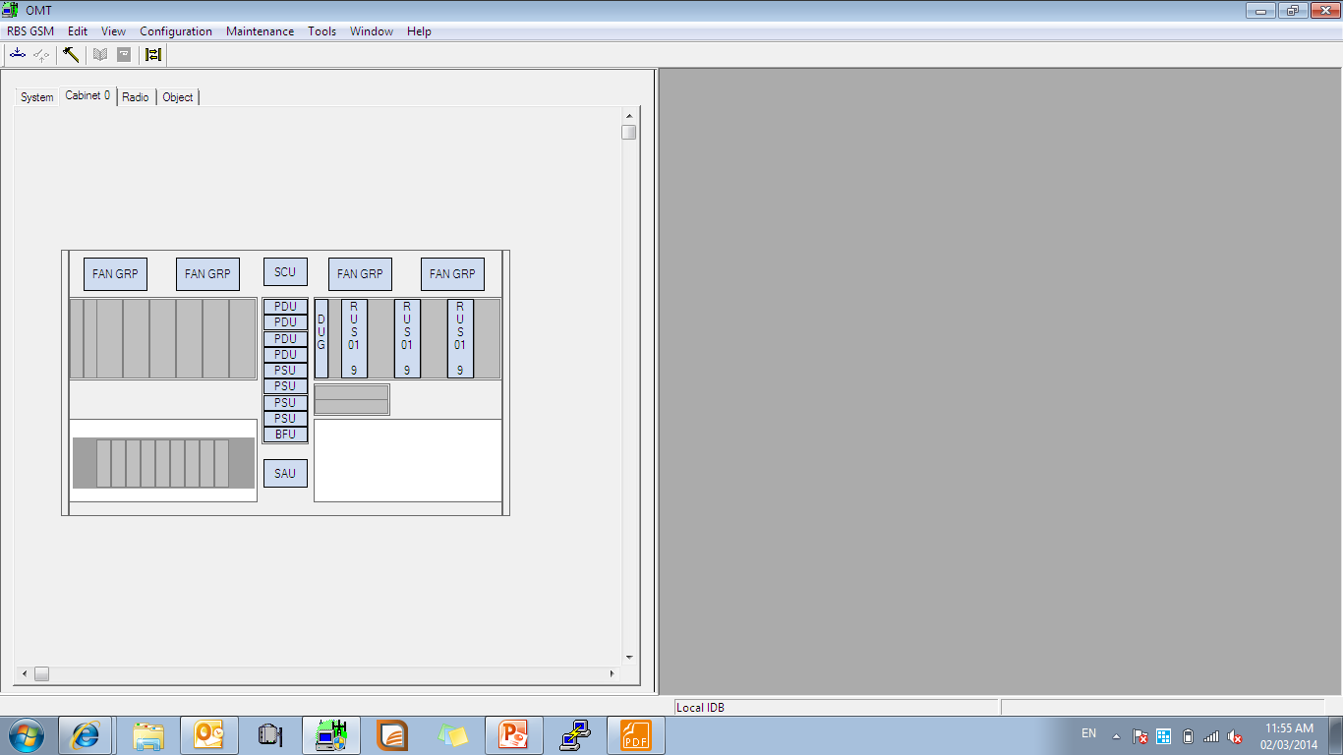
Notes:
Check your cabinet

Slide 31
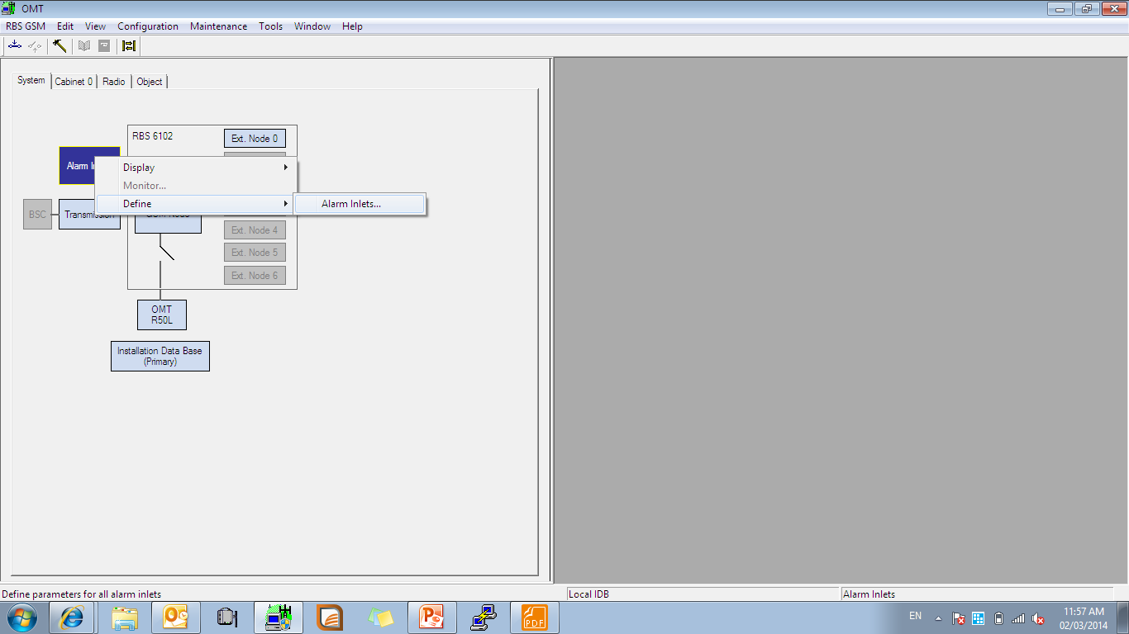
Notes:
Right click to the alarm and add smock alarm

Slide 32
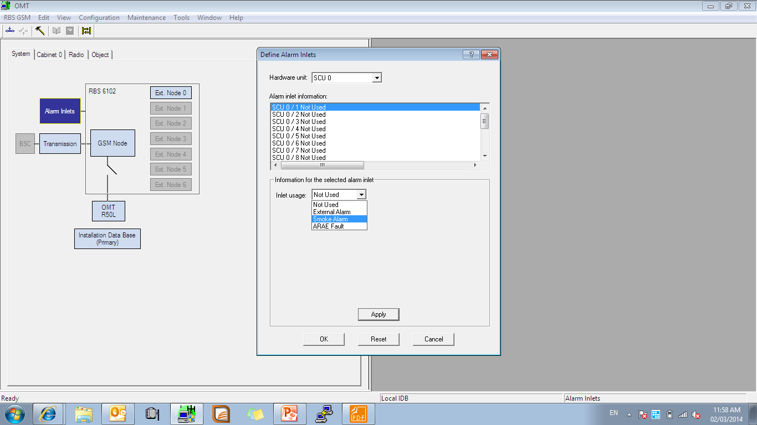

Slide 33
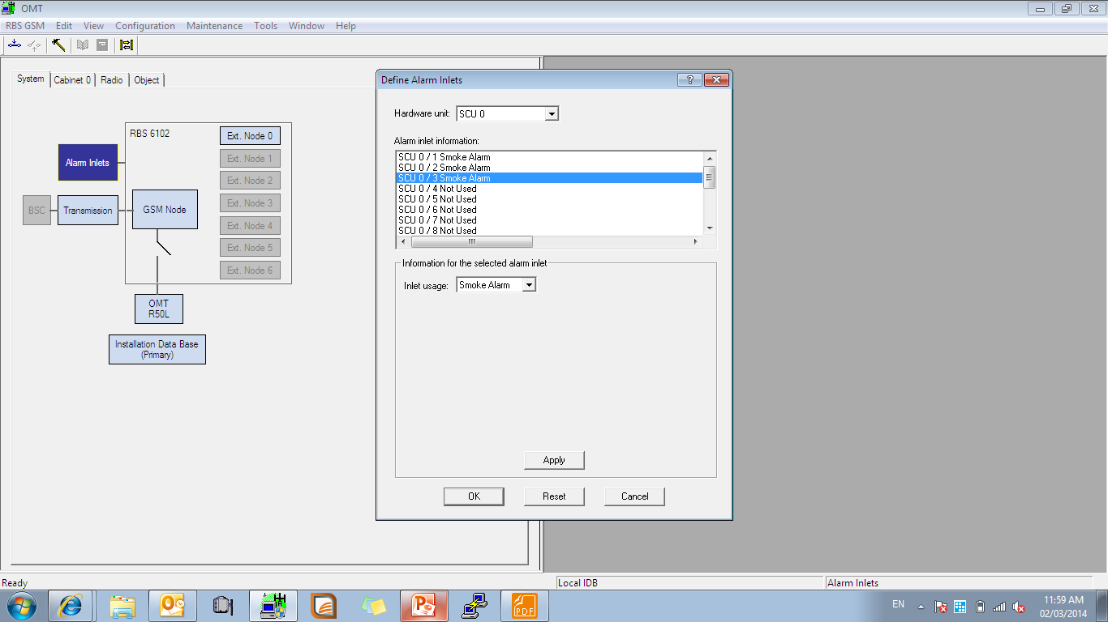
Notes:
You add smoke alarm click ok and continu

Slide 34
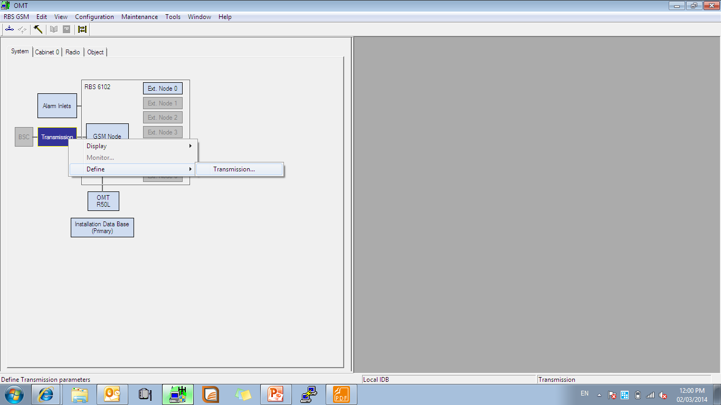
Notes:
Right click to transmission and set setting

Slide 35
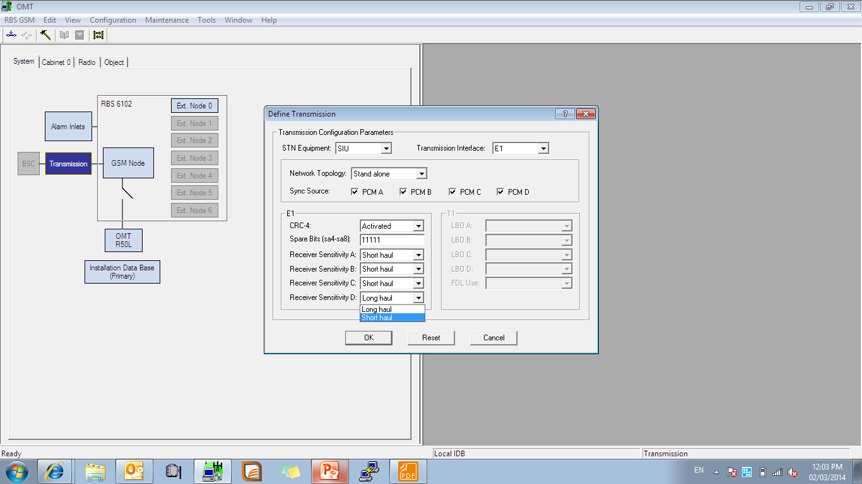
Notes:
Correct setting for define

